Slide 1
Open Government Data:
Policies, Initiatives, and Opportunities for Information Science Graduates
Eleanor “Nora” Mattern
March 29, 2019

Slide 2
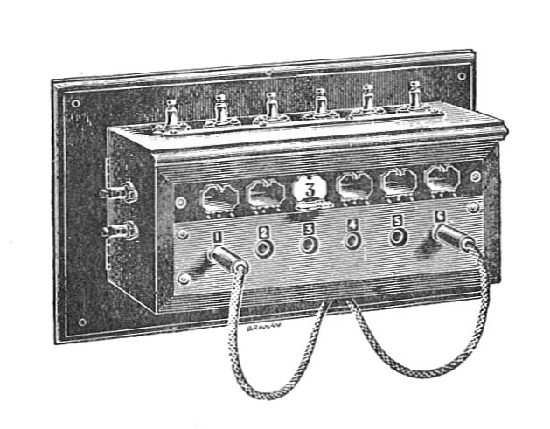
Context for Presentation
Civic Switchboard Project Work
IMLS-funded project with University of Pittsburgh Libraries, Western PA Regional Data Center, Carnegie Library of Pittsburgh (2018-2020)

Slide 3
By the end of this session, participants will be able to:
Recognize examples of “open data” by their characteristics
Describe drivers for making government data open
Identify the information skills and knowledge involved in the open data process
Discussion Prompts

Slide 4
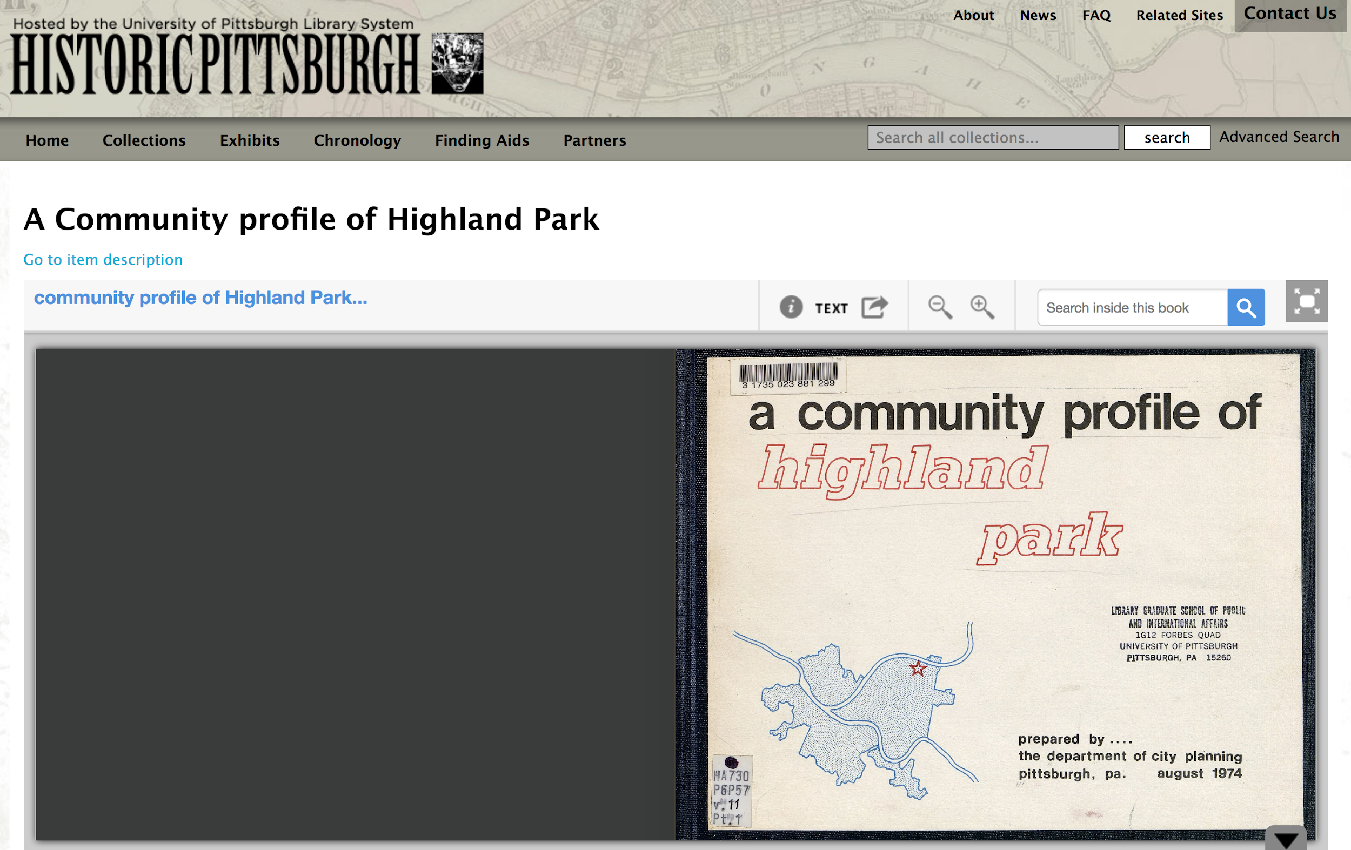
https://historicpittsburgh.org/islandora/object/pitt:31735070066125

Slide 5
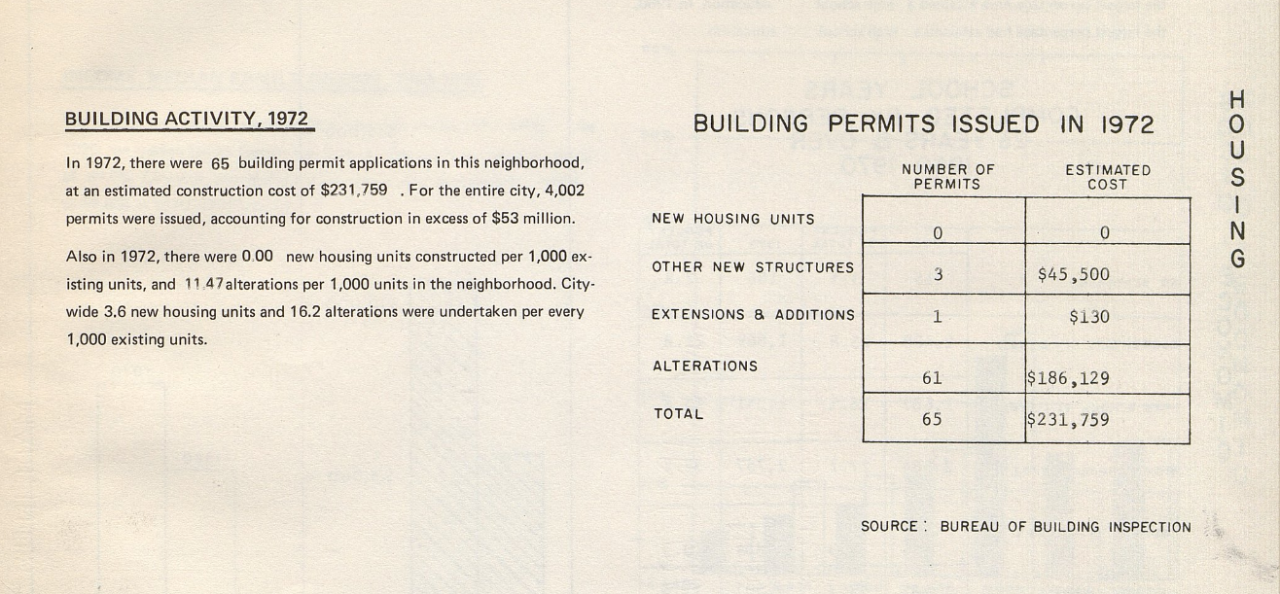
Excerpt from A Community Profile of Highland Park

Slide 6
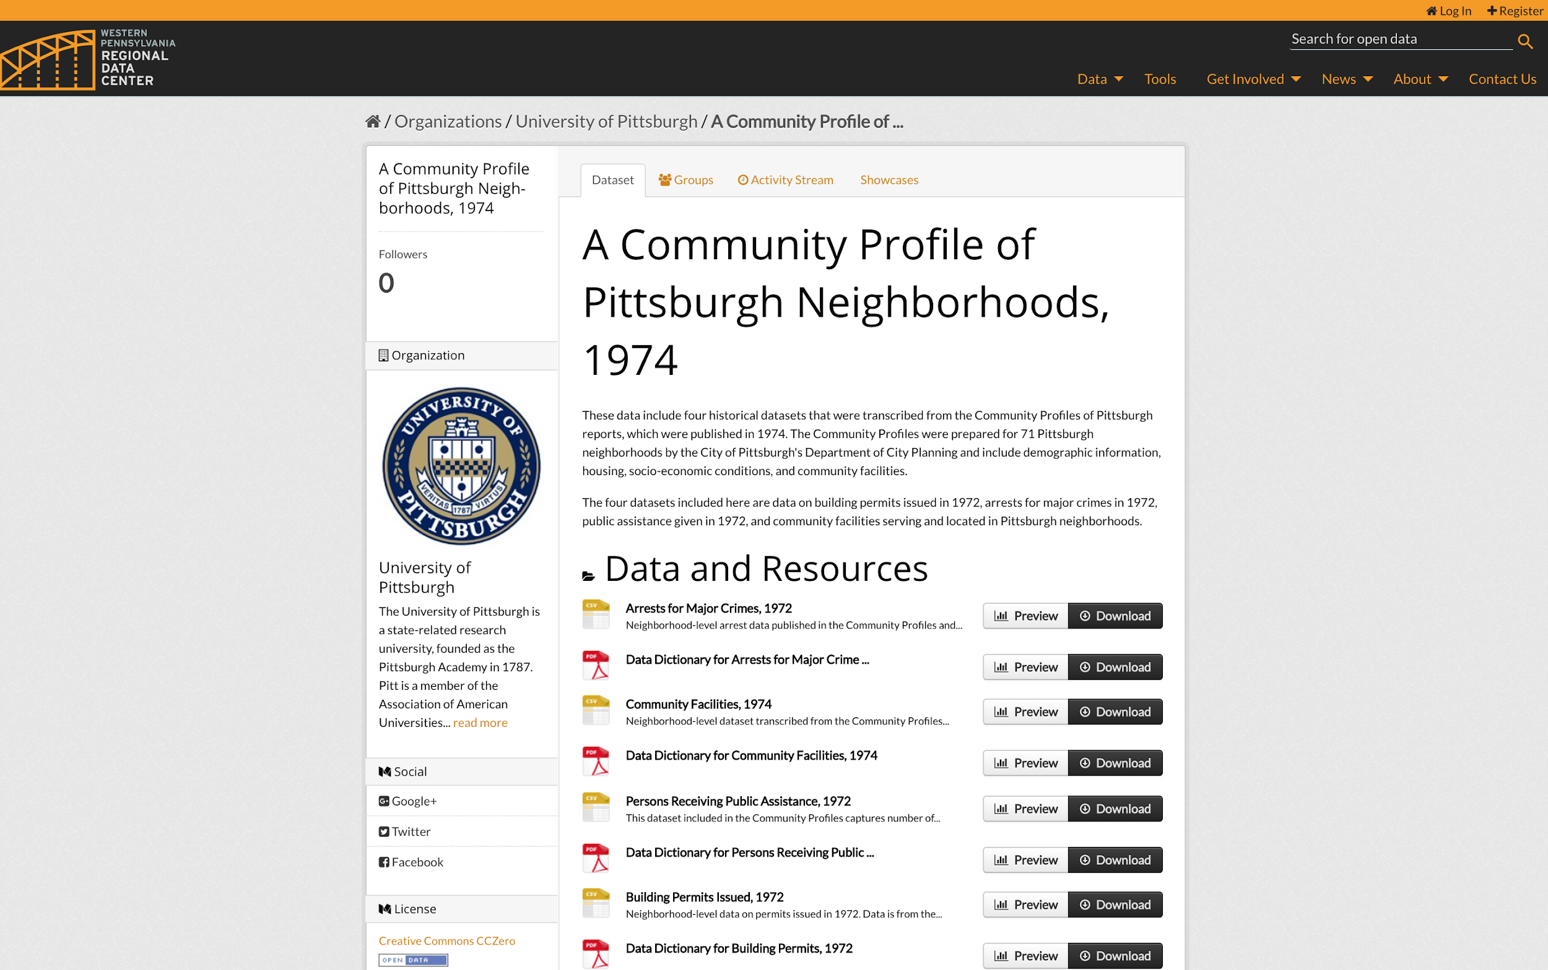
WPRDC

Slide 7
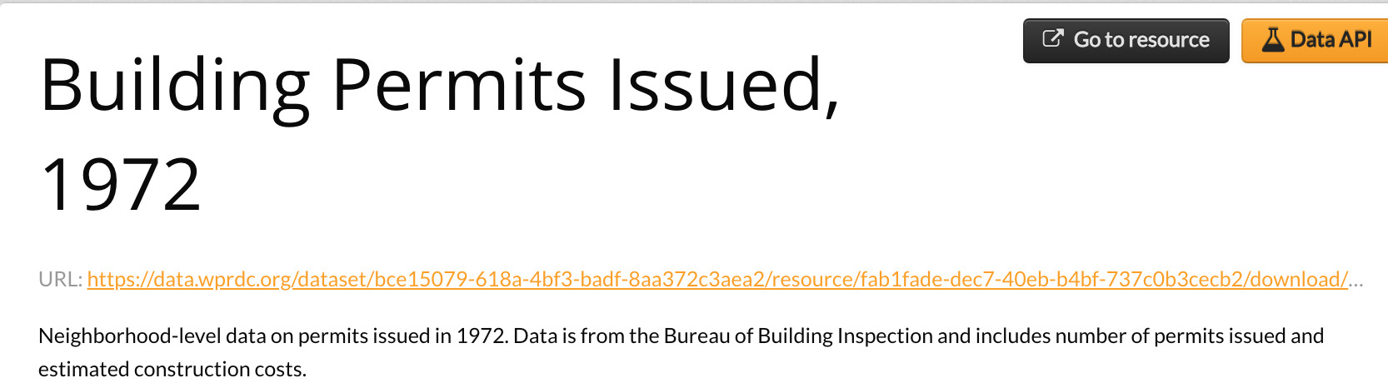

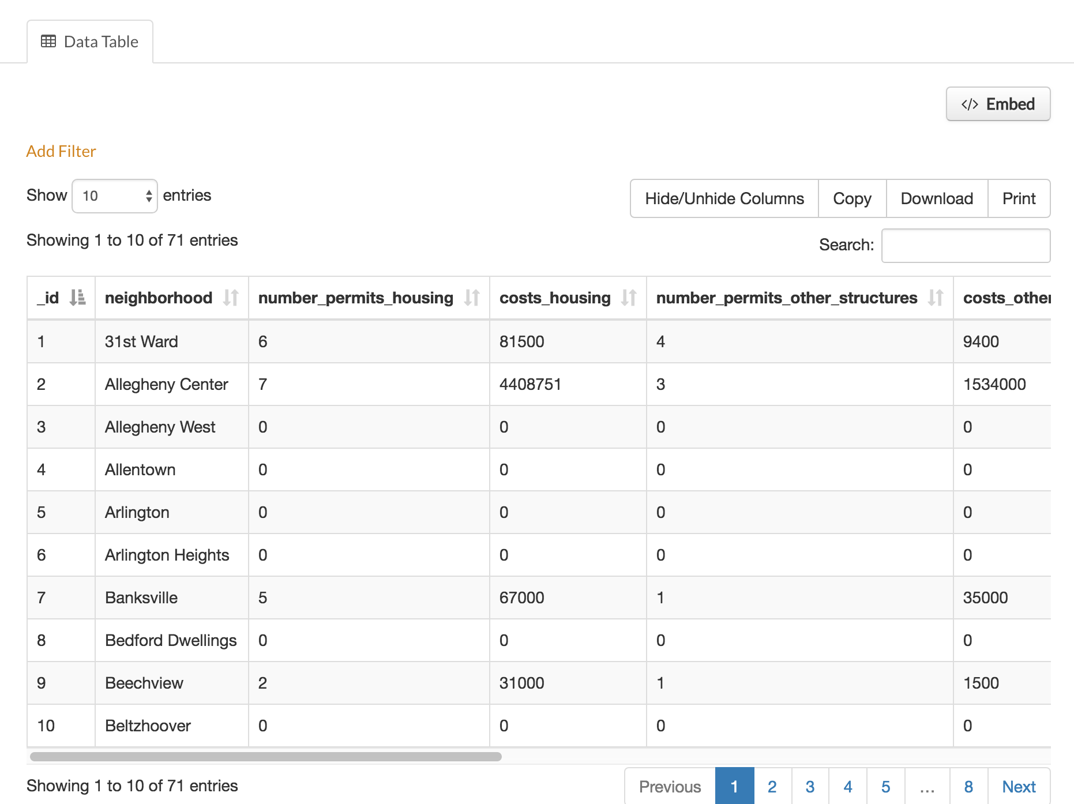
What are some differences between this new version and the original? What advantages does this new format offer to the user?

Slide 8
What are the characteristics of “open data”?
Free to access and download
Reusable by anybody for any purpose
Available in machine readable, open file formats
Absent of personally identifiable information
Timely and as complete as possible
Modification and resharing permitted
What are some terms that come to your mind when you hear “open data”?
What are some examples of information/data that a government may produce?

Slide 9
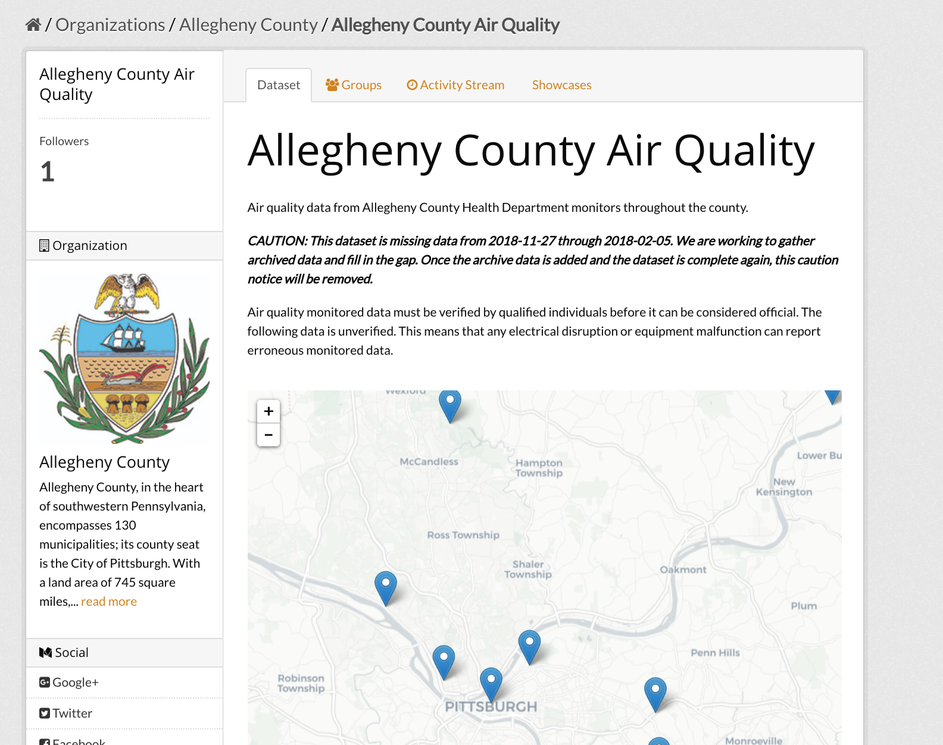
Environmental Data

Slide 10
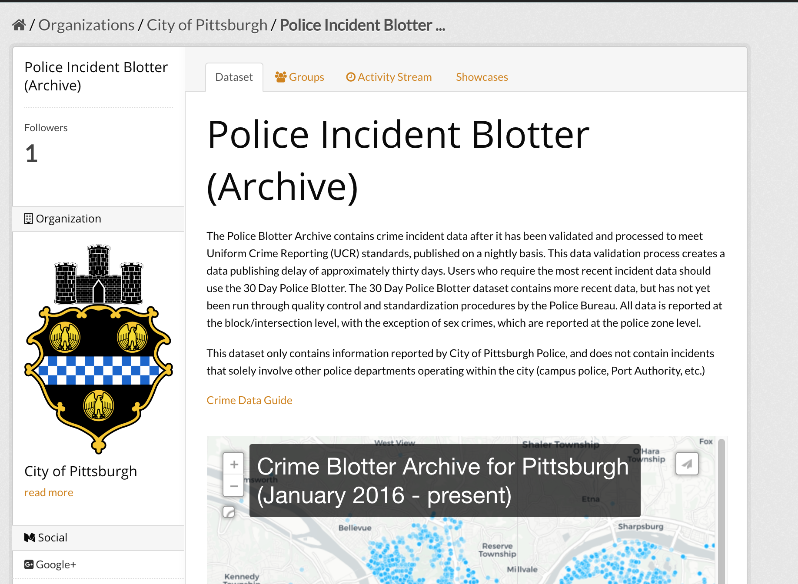
Crime Data

Slide 11
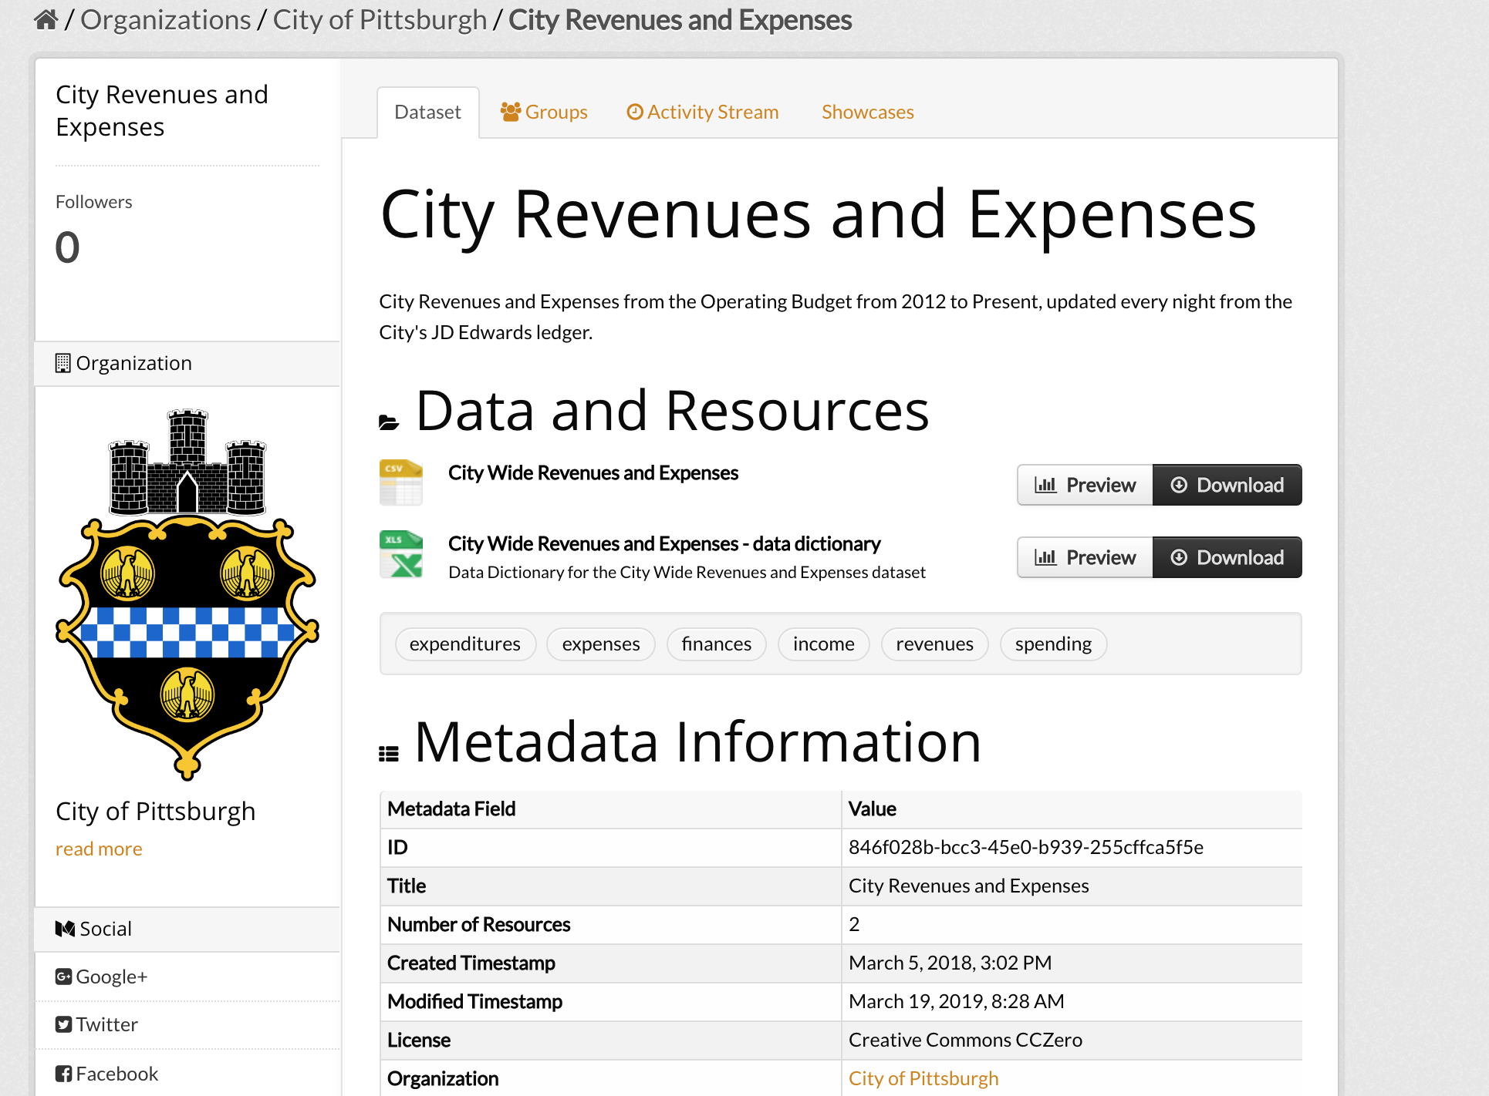
Budgetary Data

Slide 12
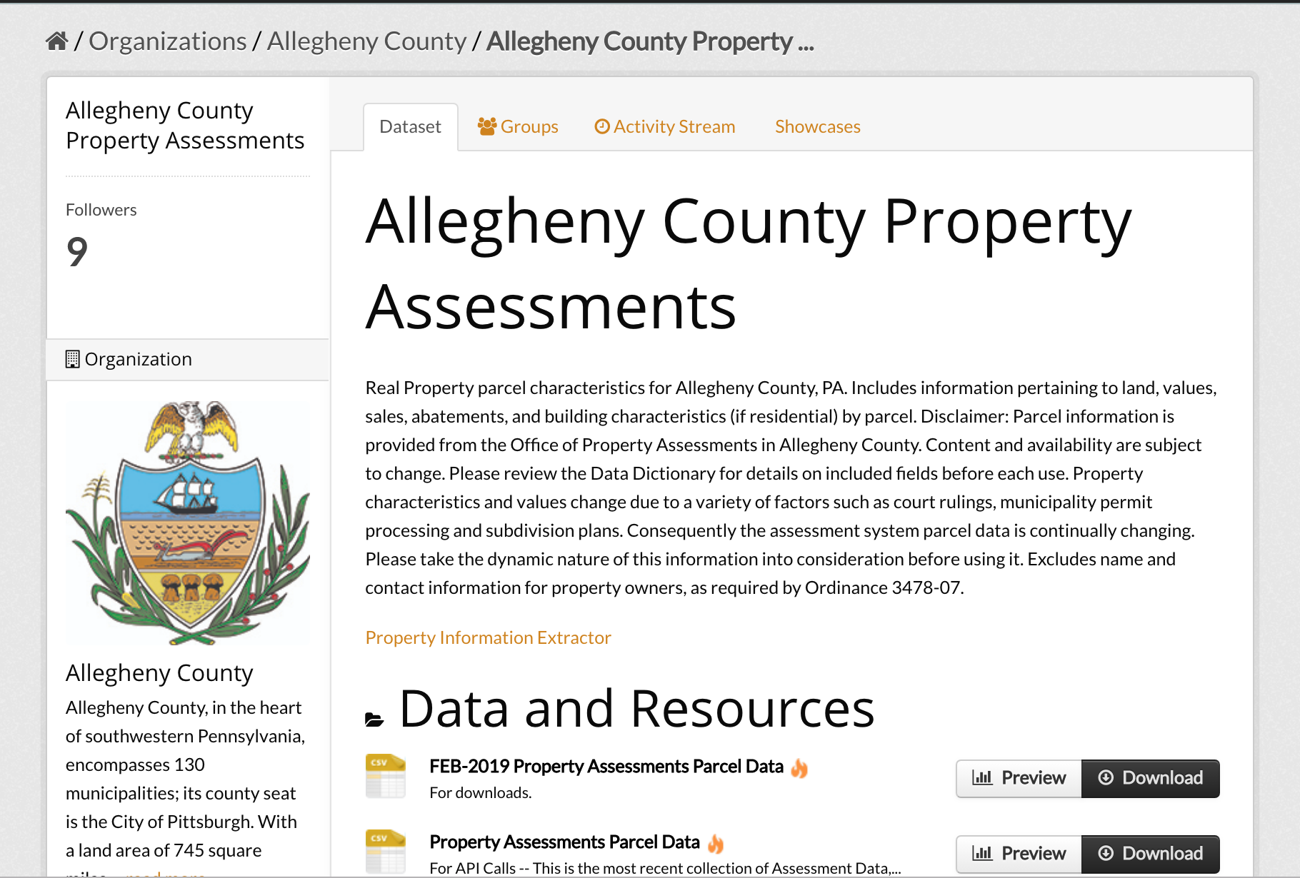
Property Data

Slide 13
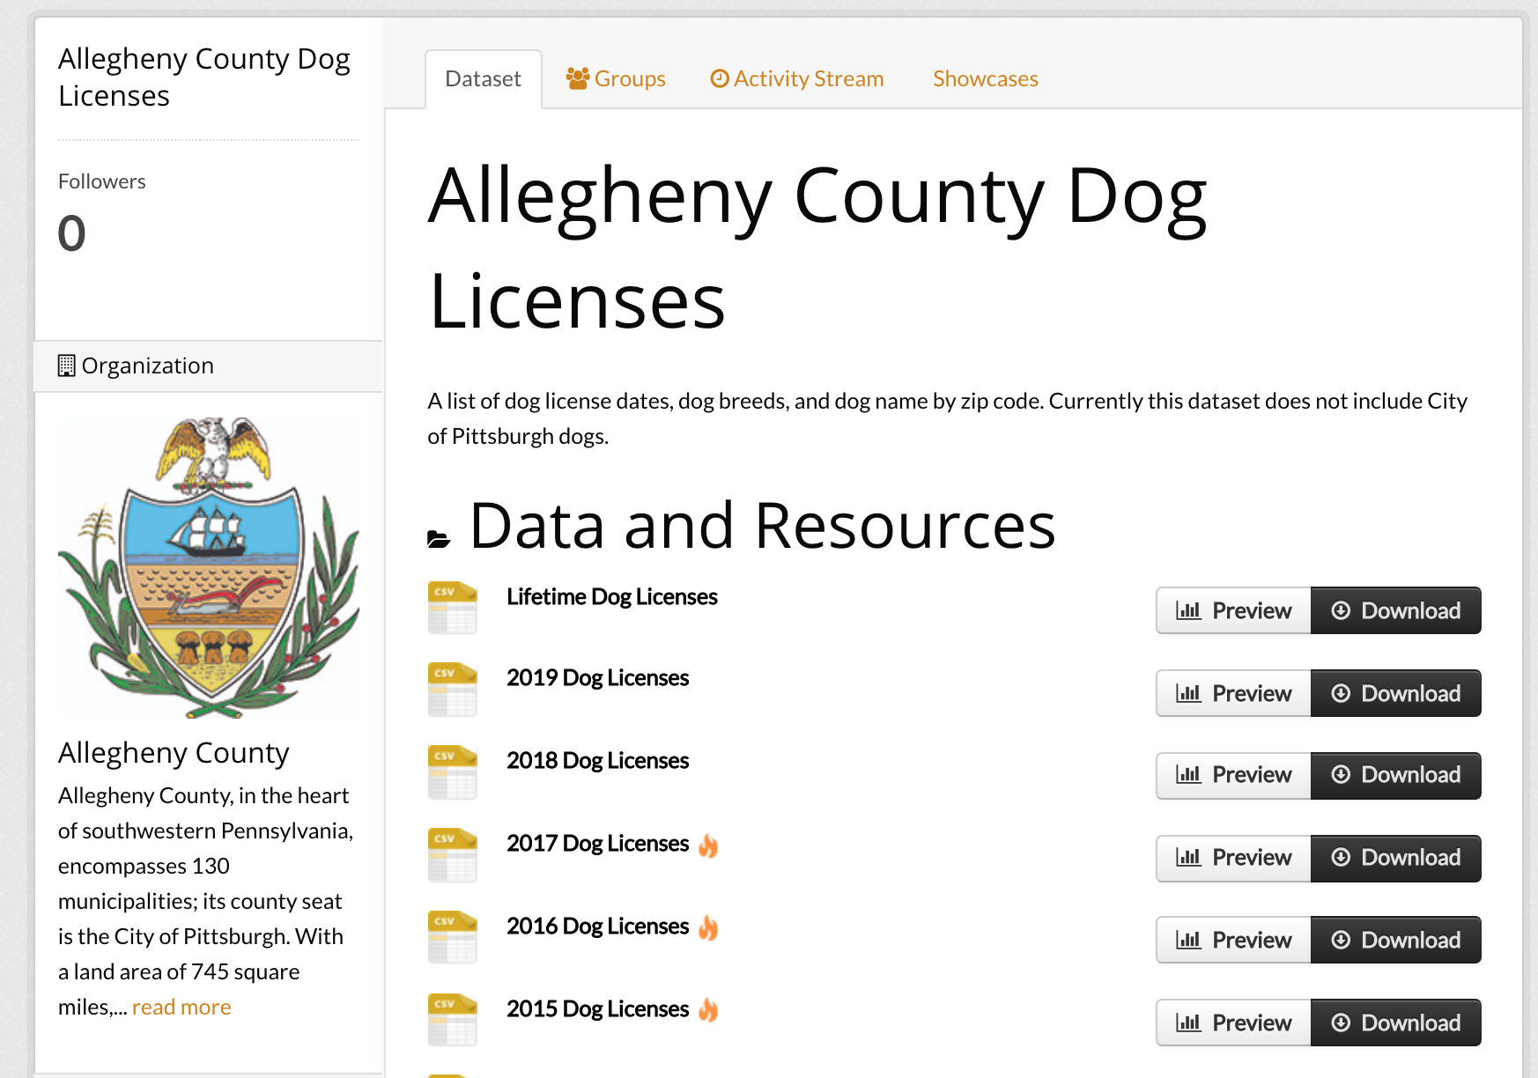
And data you might not expect to find!

Slide 14
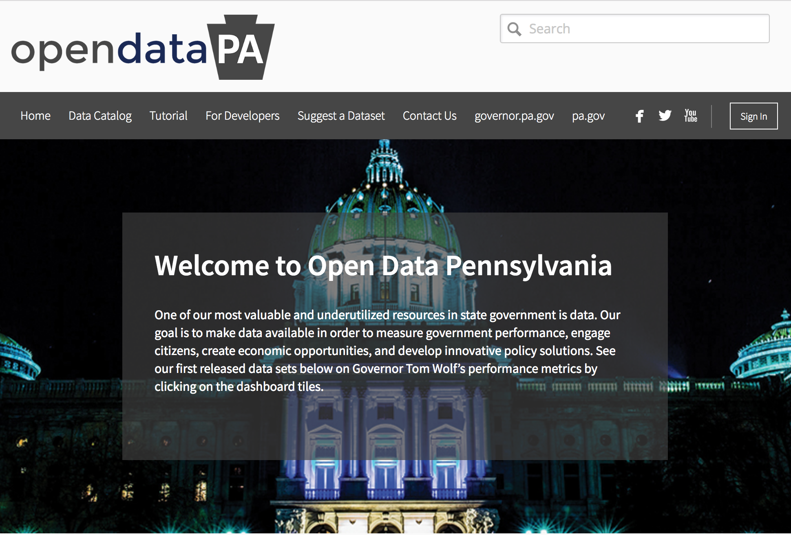
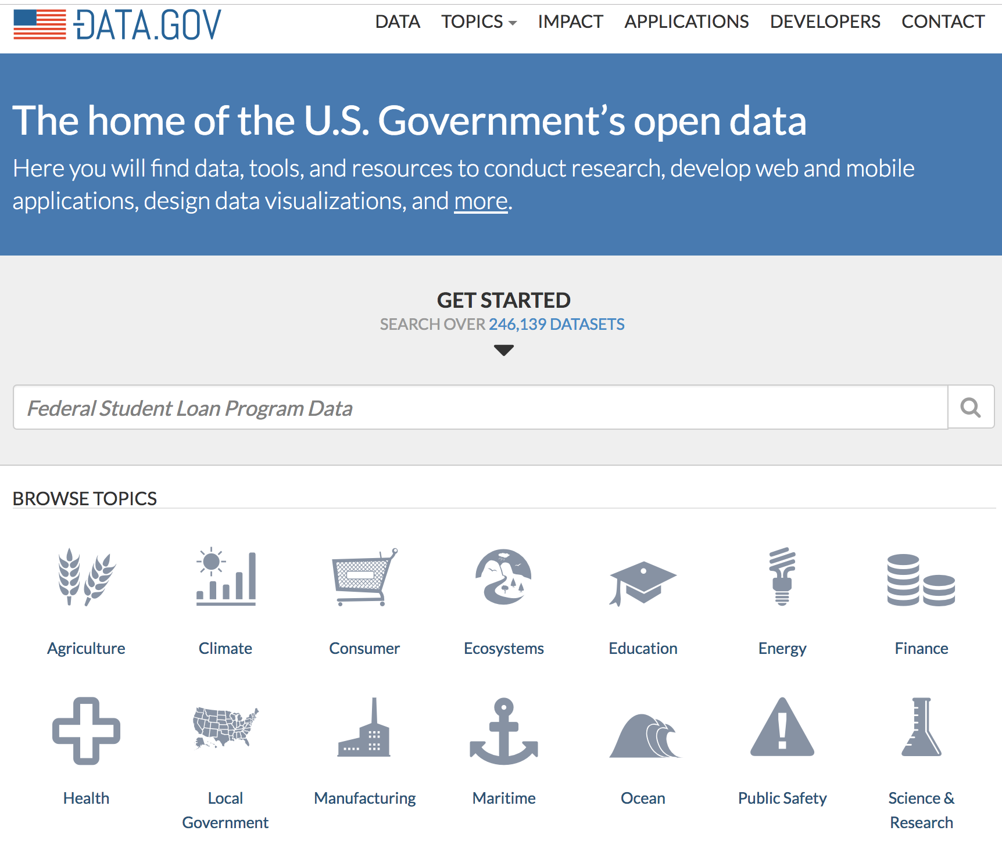

Slide 15
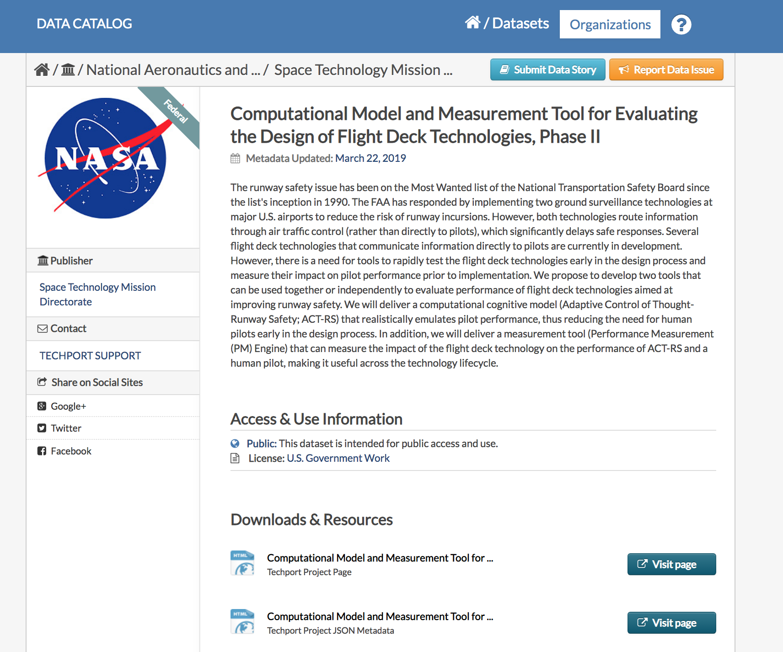
Data.gov

Slide 16





Slide 17
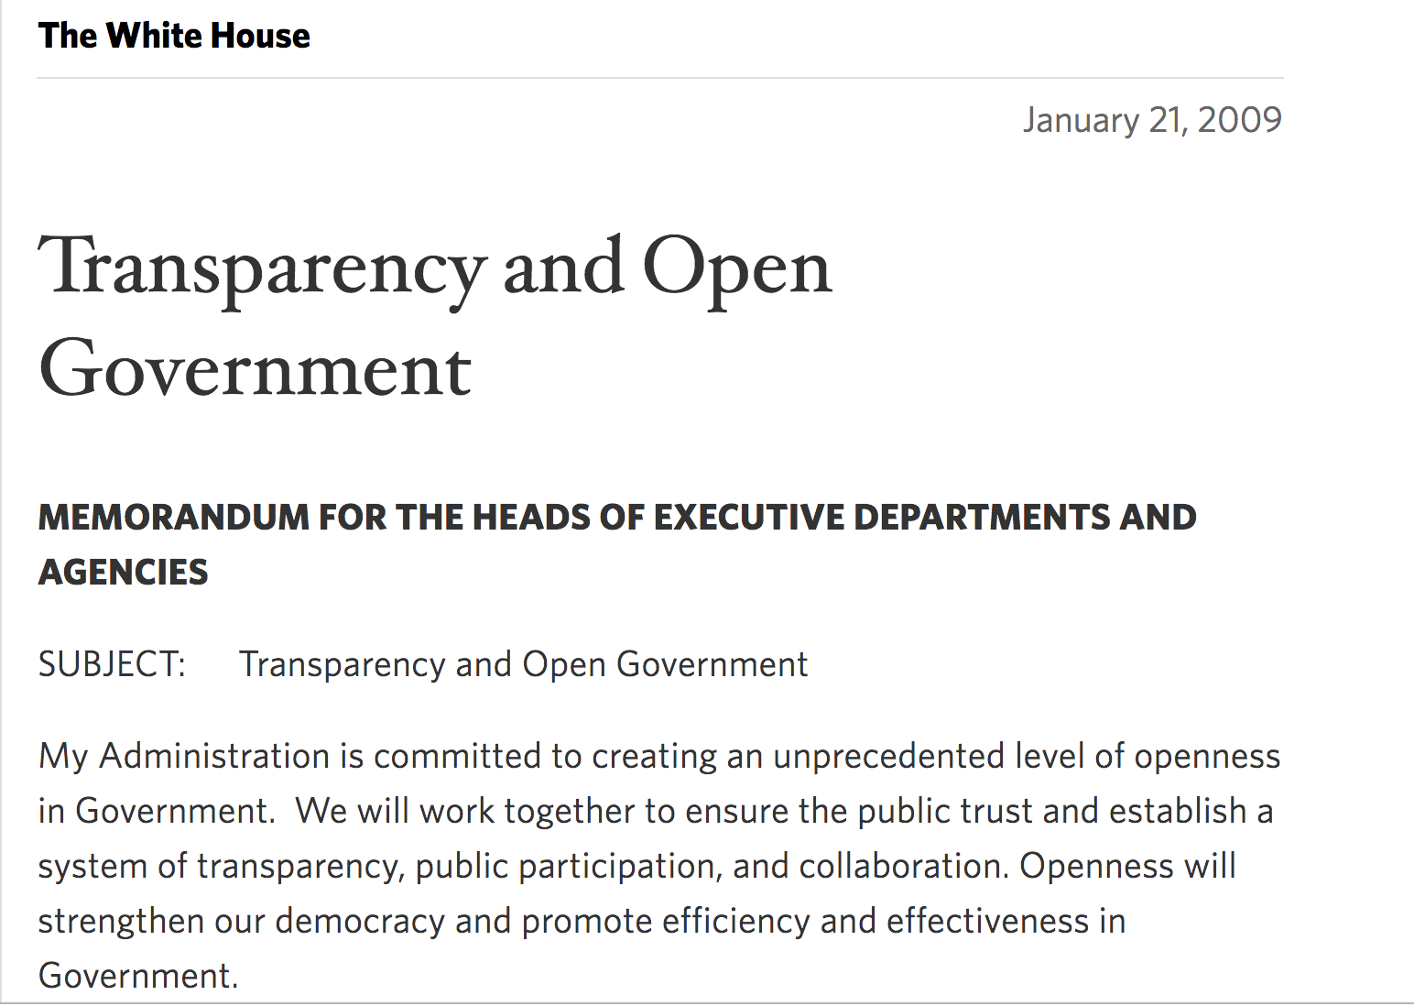
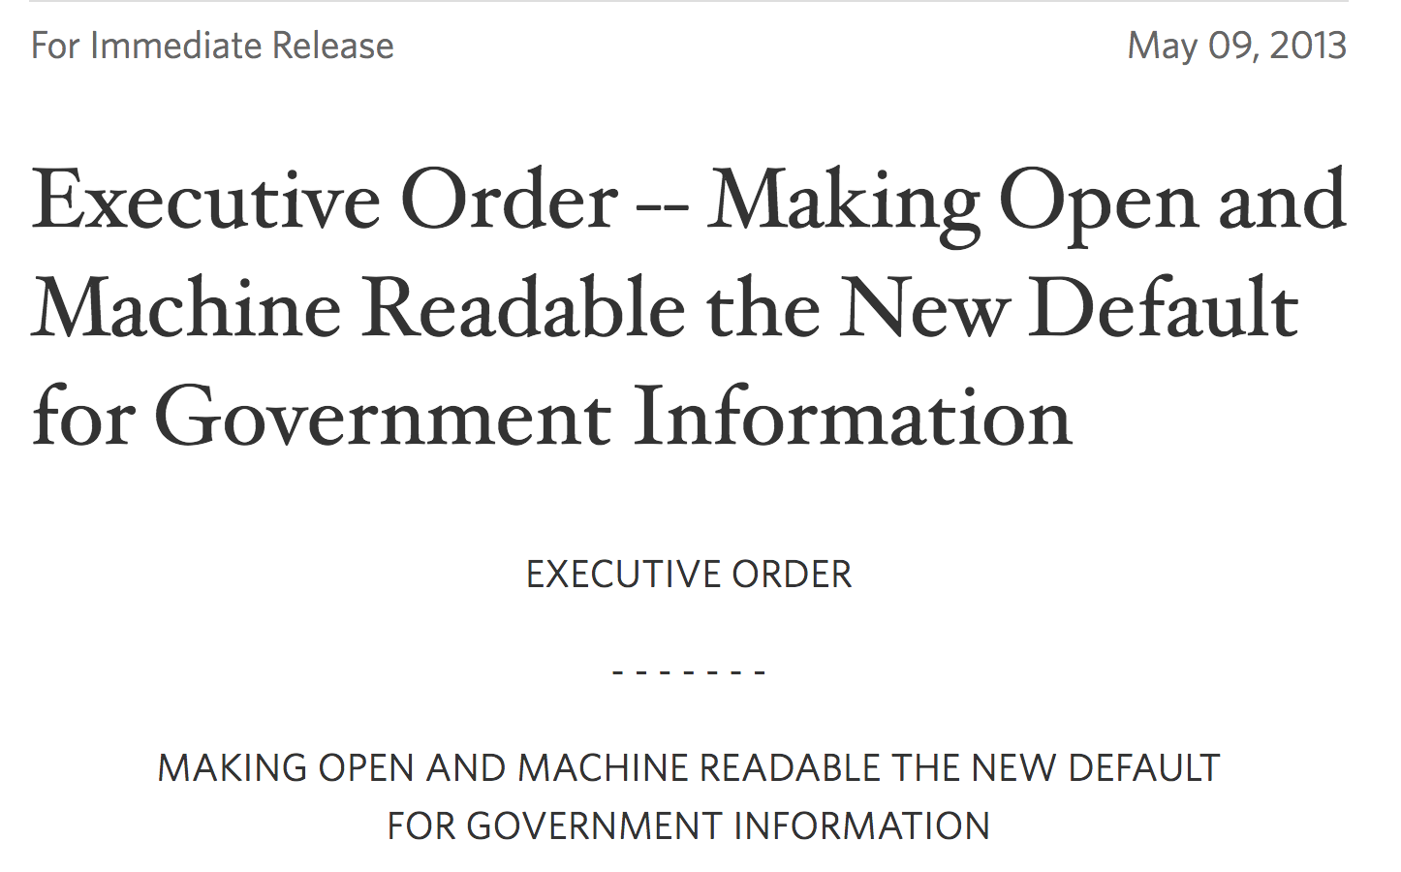


Slide 18
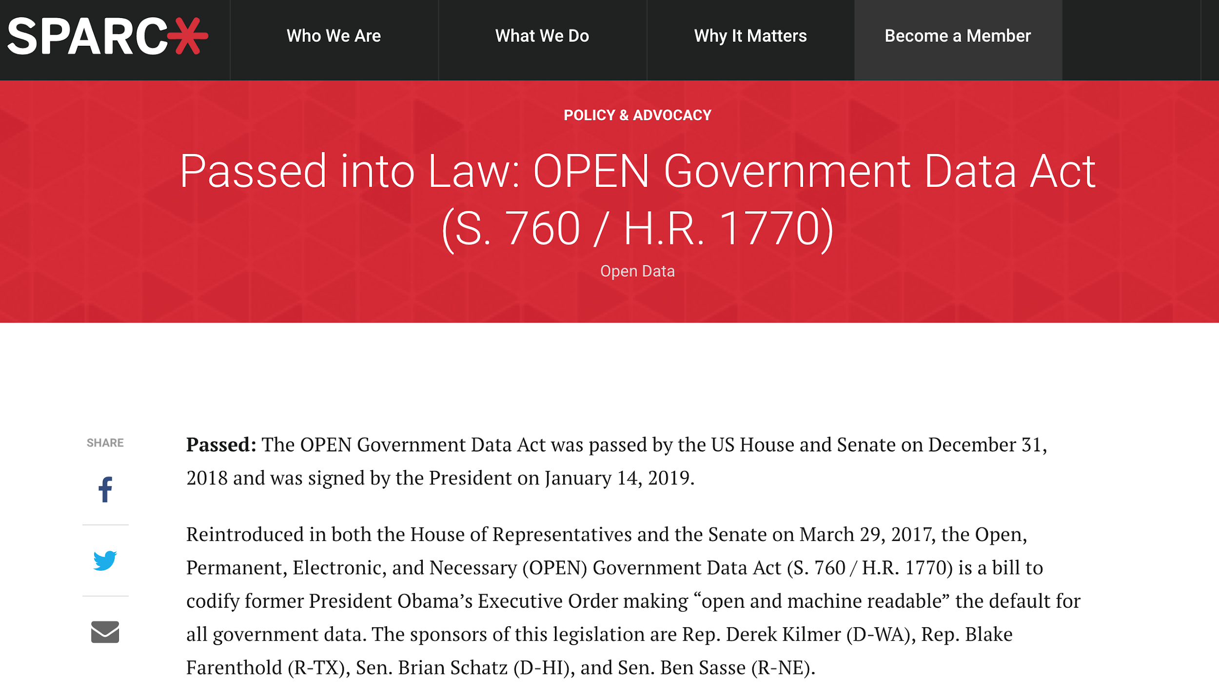
SPARC Announcement
Notes:
‘‘Open, Public, Electronic, and Necessary Government Data Act’’

Slide 19
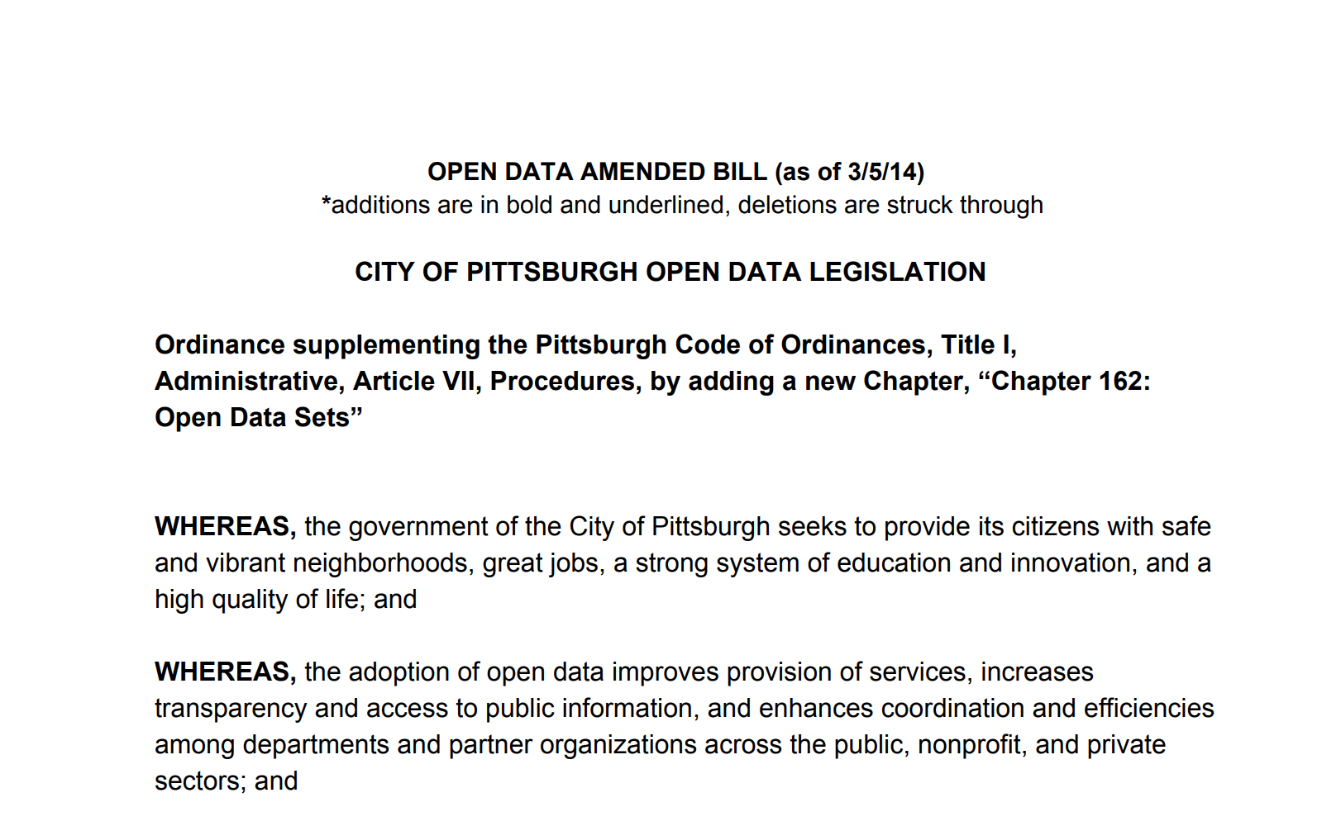
“by publishing structured standardized data in machine­-readable formats, the City of Pittsburgh seeks to encourage the local software community to develop software applications and tools to collect, organize, and share public data in new and innovative ways” - Pittsburgh Open Data Legislation (2014)

Slide 20
What are the drivers behind open data policy and initiatives in government?
“
Facilitating transparency and participatory government

Slide 21
2. Increasing internal efficiency and streamlining processes

Slide 22
3. Realizing data’s commercial, research, and societal value
“Government information --patents, corporate filings, agriculture research, maps, weather, medical research -- is the raw material of innovation, creating a wealth of business opportunities that drive our economy forward. Government information is a form of infrastructure, no less important to our modern life than our roads, electrical grid, or water system.”
Carl Malamud, “Address to the Gov 2.0 Summit, September 10, 2009

Slide 23

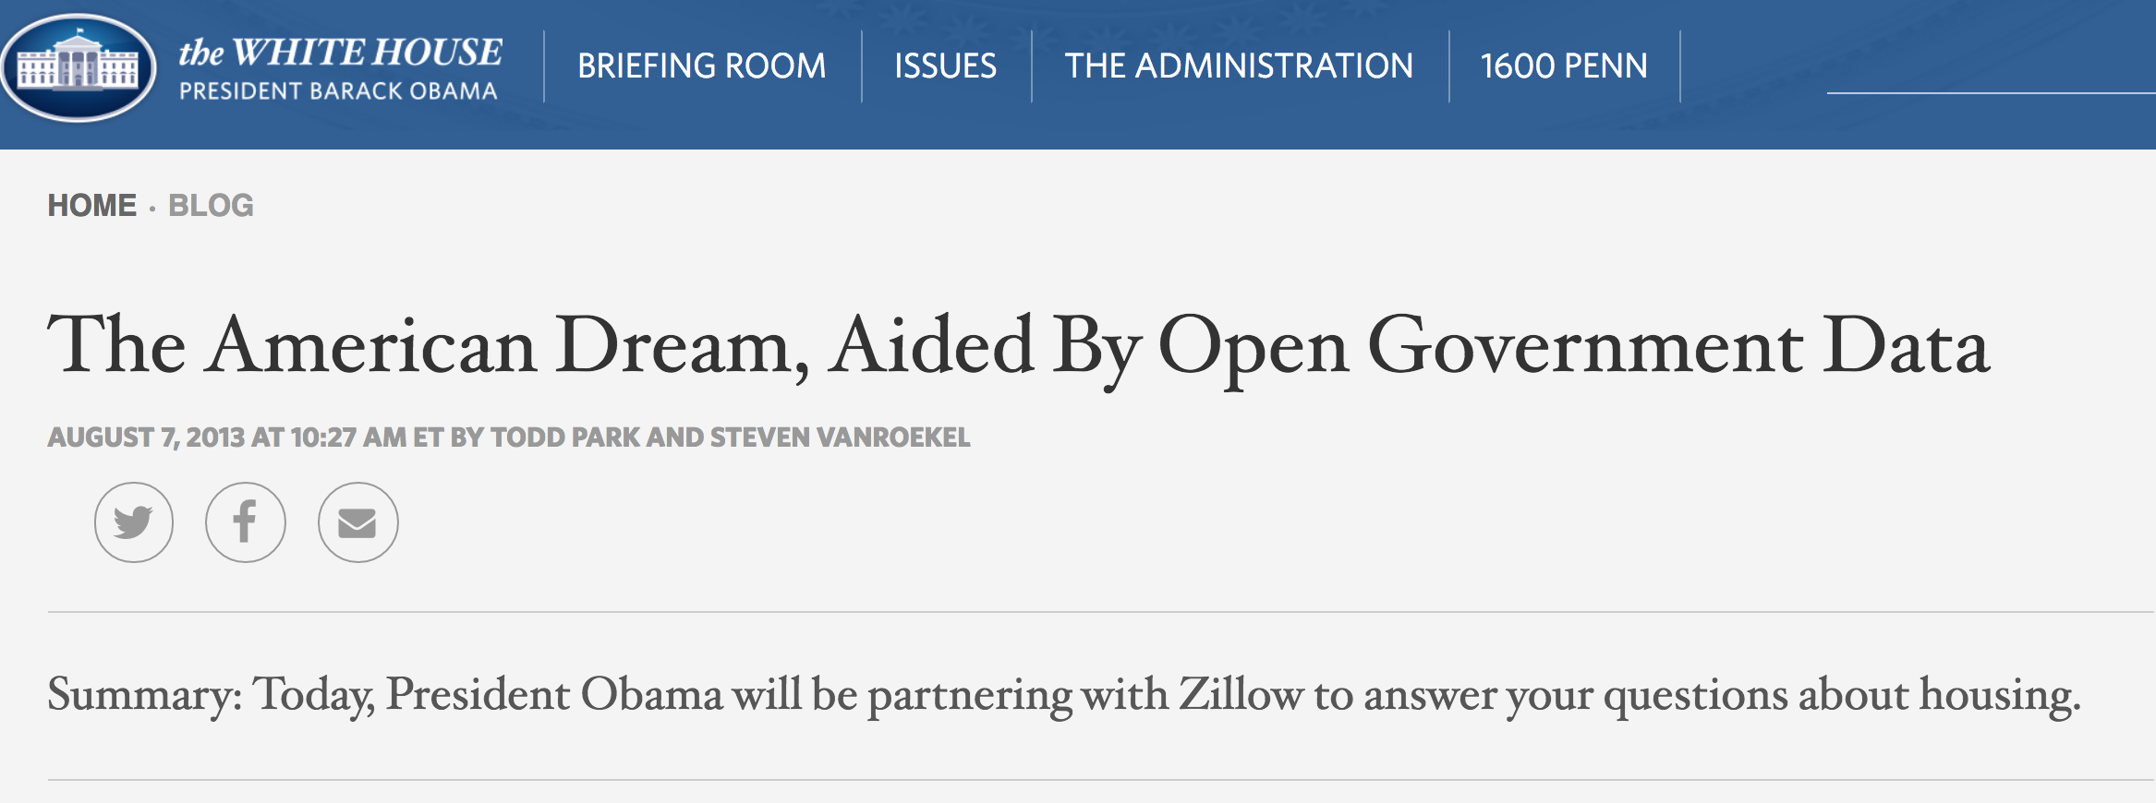
Commercial Value
Obama White House Blog Entry

Slide 24
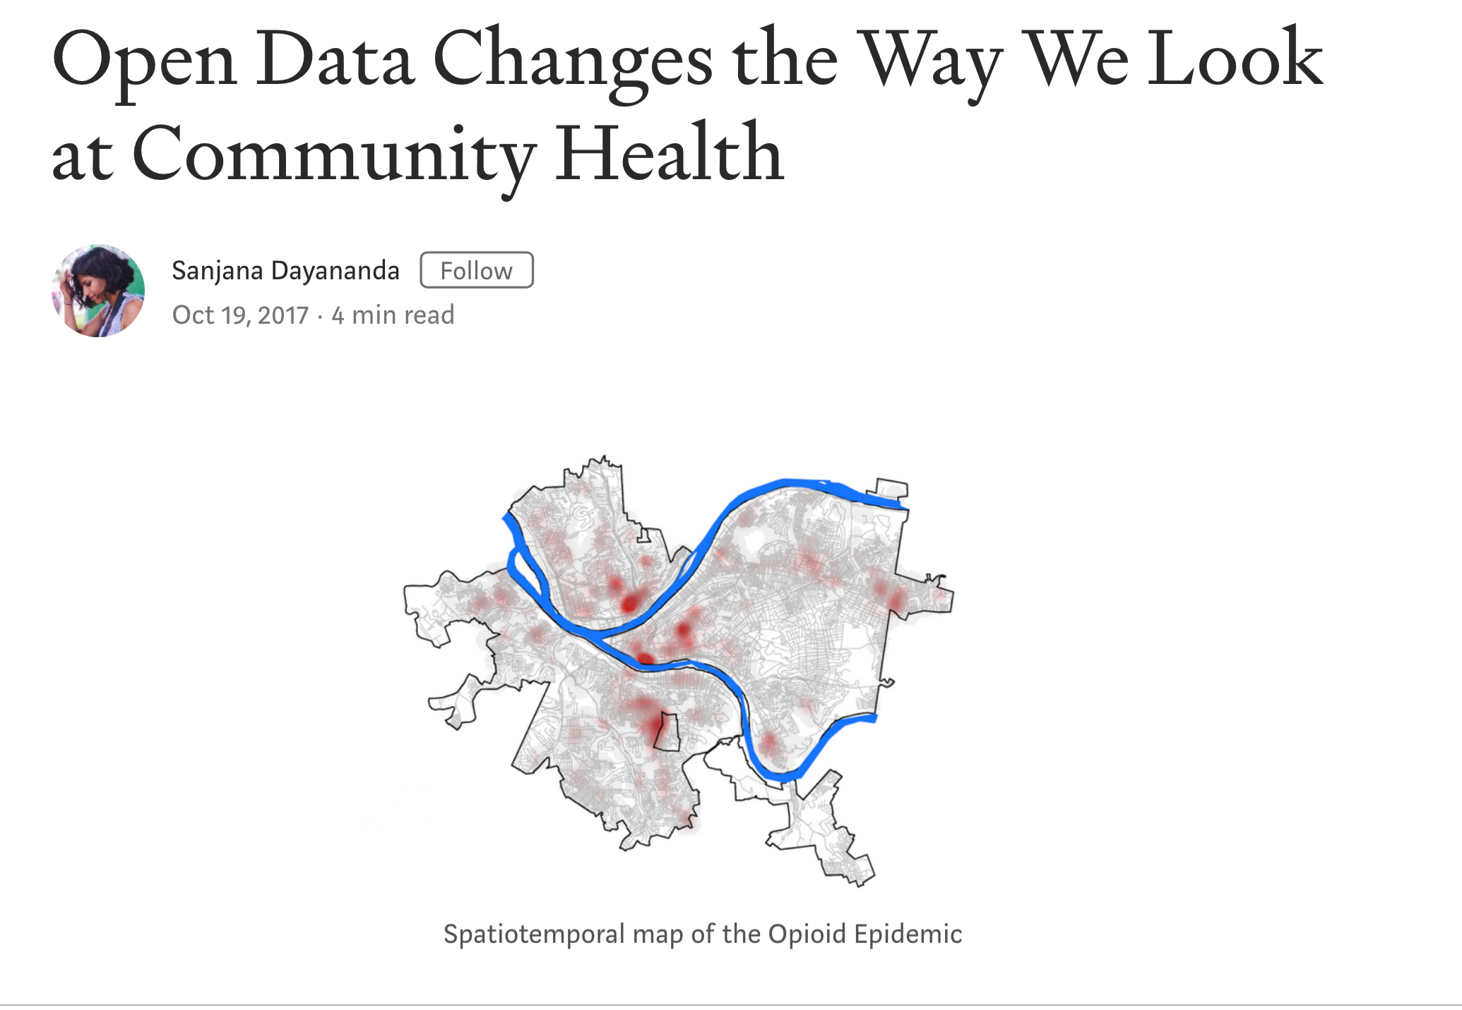
Research Value
Medium post

Slide 25
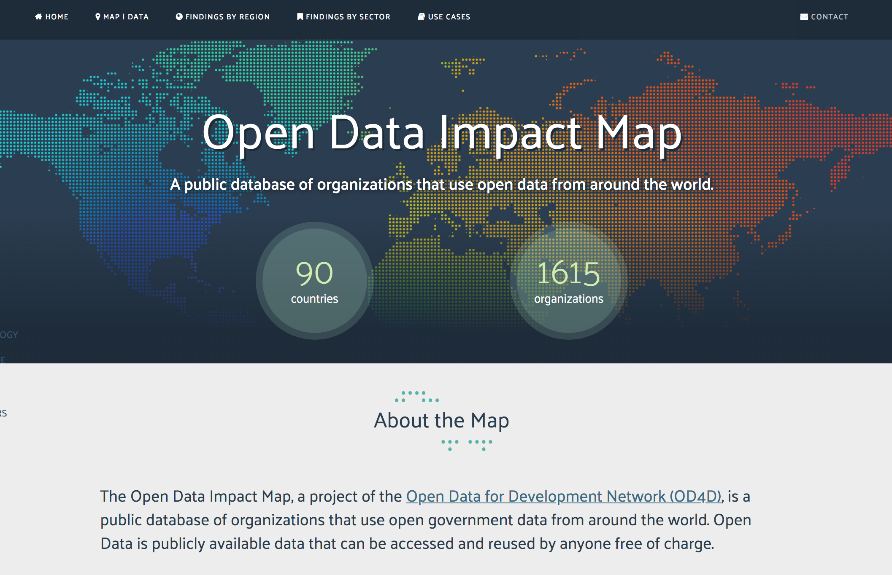
Societal Value
Open Data Impact Map

Slide 26
An Open Data Process
Data Creation
Data Selection
Ongoing data curation
“While not necessarily occurring at a fixed stage, data curation is vital in ensuring the published data is sustainable. This involves a number of processes, including updating stale data, data and metadata enrichment, data cleansing, etc.”
Data Preparation
Data Publication
Data Discovery
Data Reuse
Attard, Judie, Fabrizio Orlandi, Simon Scerri, and Sören Auer, “A systematic review of open government data initiatives,” Government Information Quarterly 32 (2015): 403.

Slide 27
Data Creation
“[A]uditing government data -- determining what’s collected, how it’s collected, what it’s used for, and how accurate it is -- should be a priority… We can’t create data-driven decision-making processes when the data itself is unreliable. Whether it’s bad data on crime rates, spending programs, or the disposition of nuclear waste, it’s awfully hard to make decisions when you’re basing them on faulty data.”
Bill Allison, “My Data Can’t Tell You That,” in Open Government (Sebastopol, CA: O’Reilly Media) p. 265

Slide 28
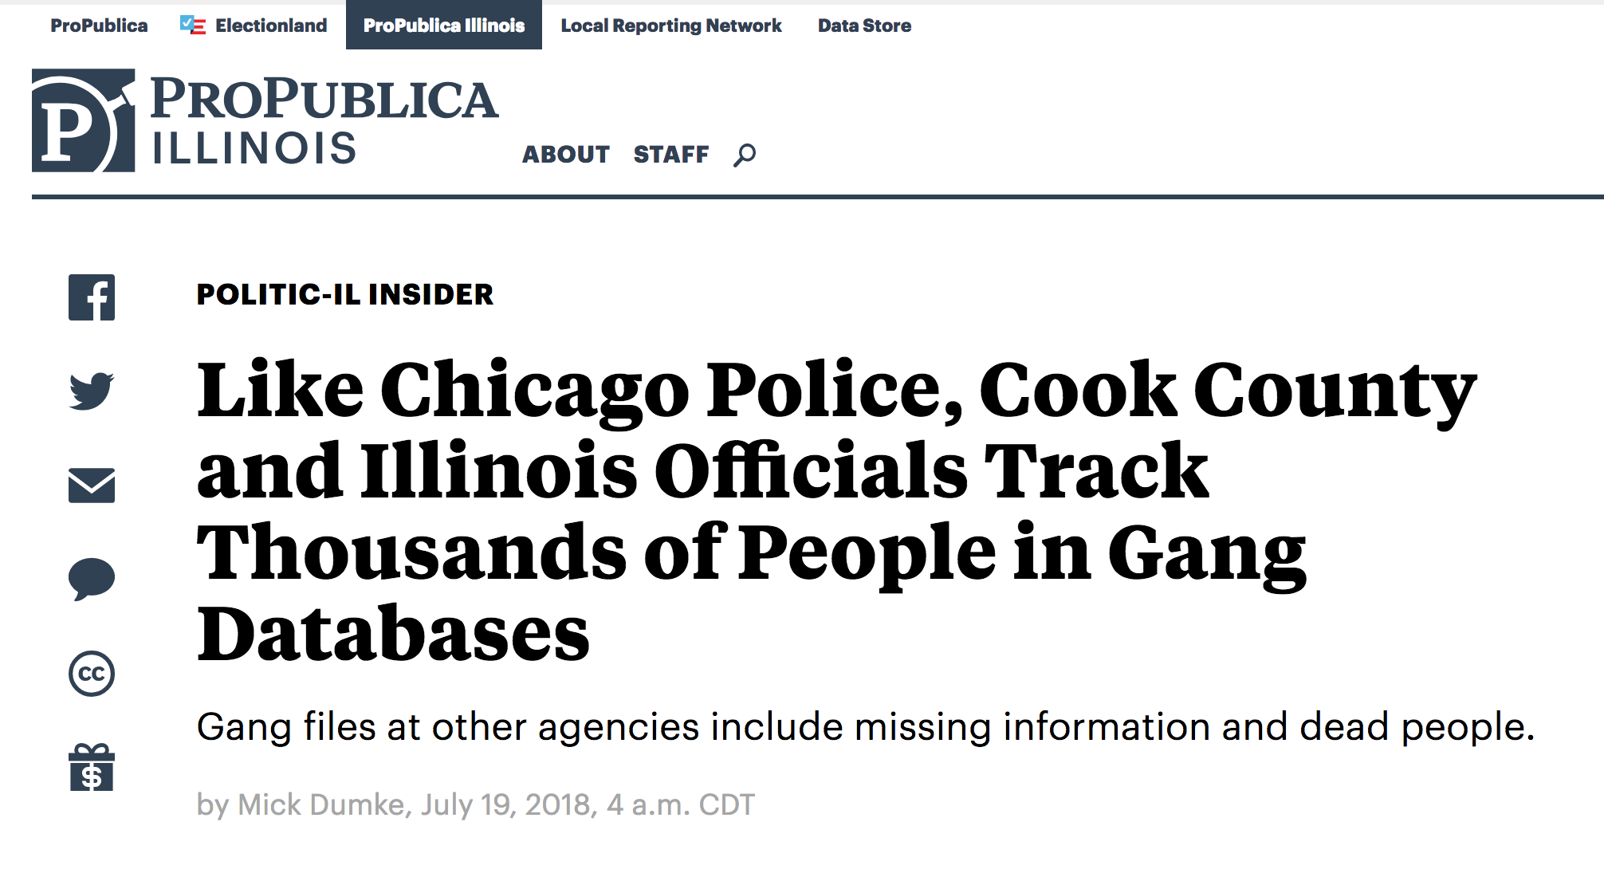
ProPublica, July 19, 2018

Slide 29
Data Selection
What should be prioritized for release?
What data legally cannot be released?
Where may there be ethical issues in releasing data? What would have to be done to data to make them available?
What are users must interested in accessing?
Notes:
Understanding our users are critical here

Slide 30
“at a minimum – governments should concentrate on The 3 B’s: Buses (transit data), Bullets (crime data) and Bucks (budget & expenditure data).”
Mark Headd, former Chief Data Officer for the City of Philadelphia

Slide 31
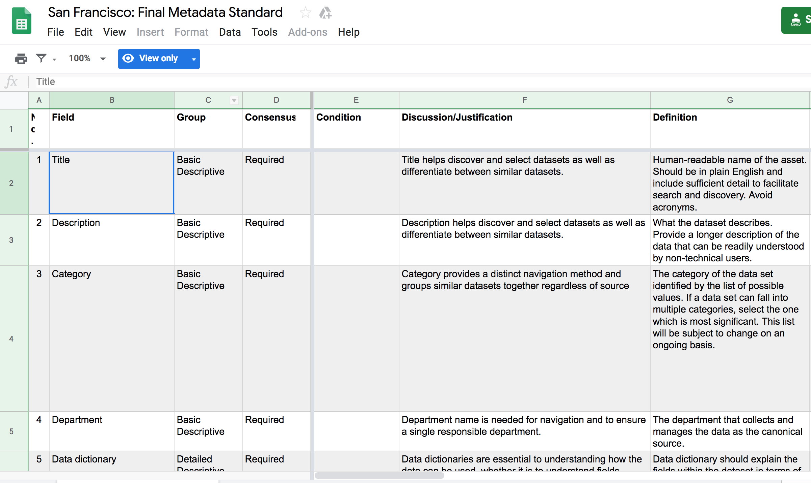

Data Preparation
PII
.csv

Slide 32


Data Publication
Data Portals and APIs
“All publishing is not equal -- instead, the way data is formatted and delivered makes a big difference.”
David G. Robinson, Harlan Yu, and Edward W. Felton, “Enabling Innovation for Civic Engagement,” in Open Government (2010), 84
Notes:
“In the case of data APIs, they offer a way to get some small slice of some large data set that lives on a server.”
ortal is more commonly a single entry point hosting the actual data, where end users can search and access the published data and explore or interact with it in some manner. A key function of a data portal is the management of metadata for the datasets -- here is an opportunity for information professionals groudned in metadata and description practices

Slide 33
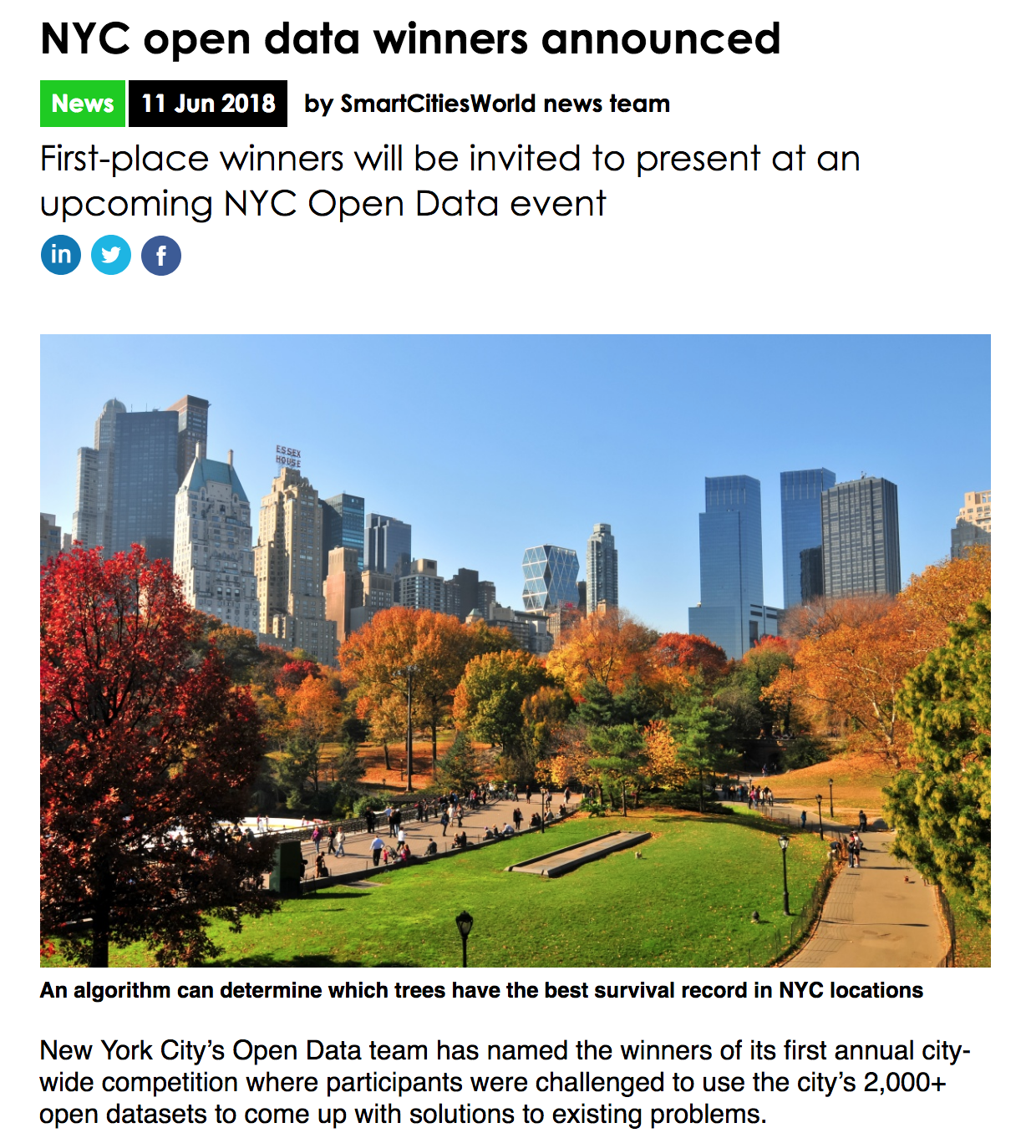
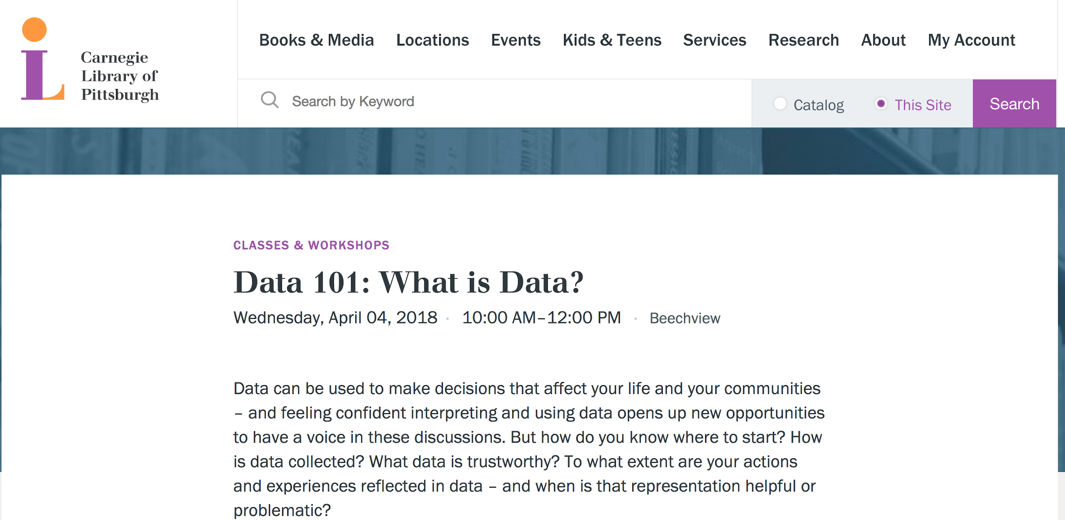
Data Discovery
Data Reuse

Slide 34
“As data can often be generated and provided in huge amounts and through multiple sources, specific needs for processing, curation, linking, and visualization result in the need for open data approaches. Pipelines in the forms of APIs are being created, in which open data is transmitted in real time, for creating new applications and changing citizen behaviour. Cloud services are in parallel changing the ways of providing and using open data, based on vast virtualized resources offering security, privacy and scalability. Data analytics fill in the decision-making process, for citizens, businesses and administrations, providing new ways to model, simulate and even co-create the future.”
Yannis Charalabidis, Anneke Zuiderwijk, Charalampos Alexopoulos, Marijn Janssen, Thomas Lampoltshammer, and Enrico Ferro. “Preface.” In The World of Open Data (Cham, Switzerland: Springer International Publishing): xi

Slide 35
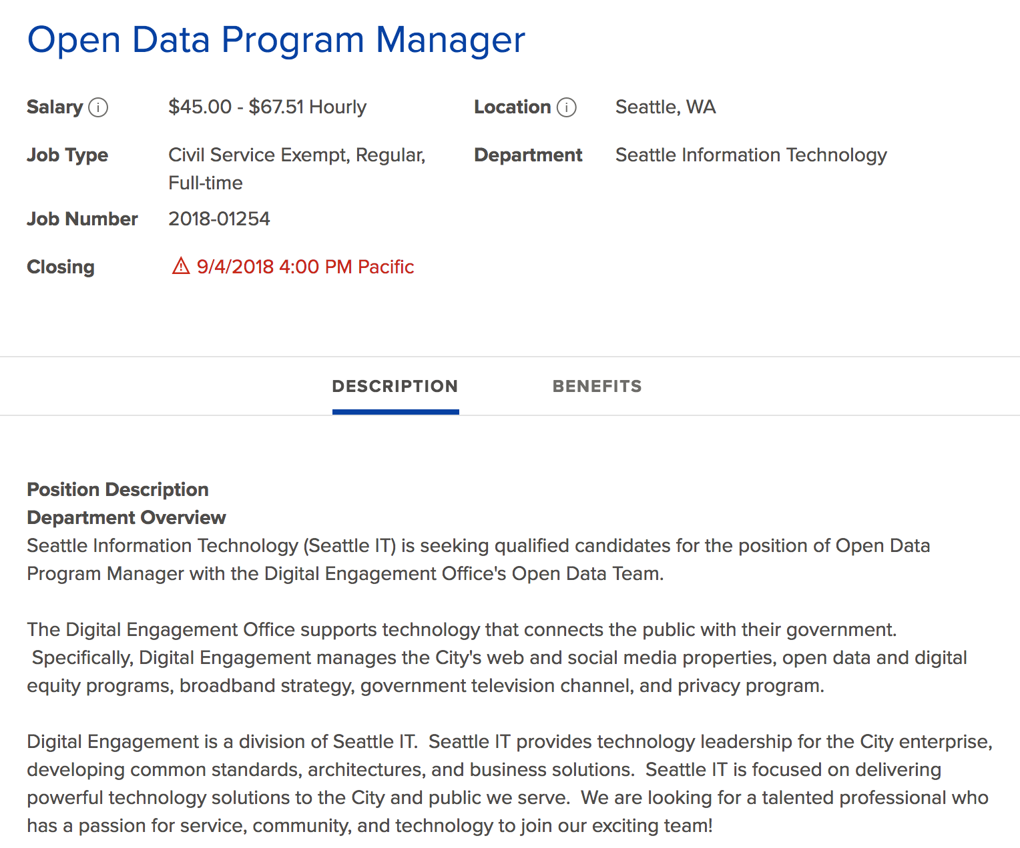
“BA or advanced degree in Data Science, Information Science, Computer Science, Information Technology or a closely related field.”
Sample position with City of Seattle

Slide 36
Open Data Challenges (and opportunities for Information Science students)
Complex privacy issues
Local governments struggling to manage data
Resources involved in preparing data for sharing (people and infrastructure costs)
Uneven standards in data collection and publication
Connecting with users and growing data literacy
Scaling workflows as data continue to grow
Balancing between publishing high quality data versus publishing at high quantity
Preserving the applications and tools developed using open data

Slide 37
Thank you!
Nora Mattern
nora.mattern@gmail.com

