Slide 1
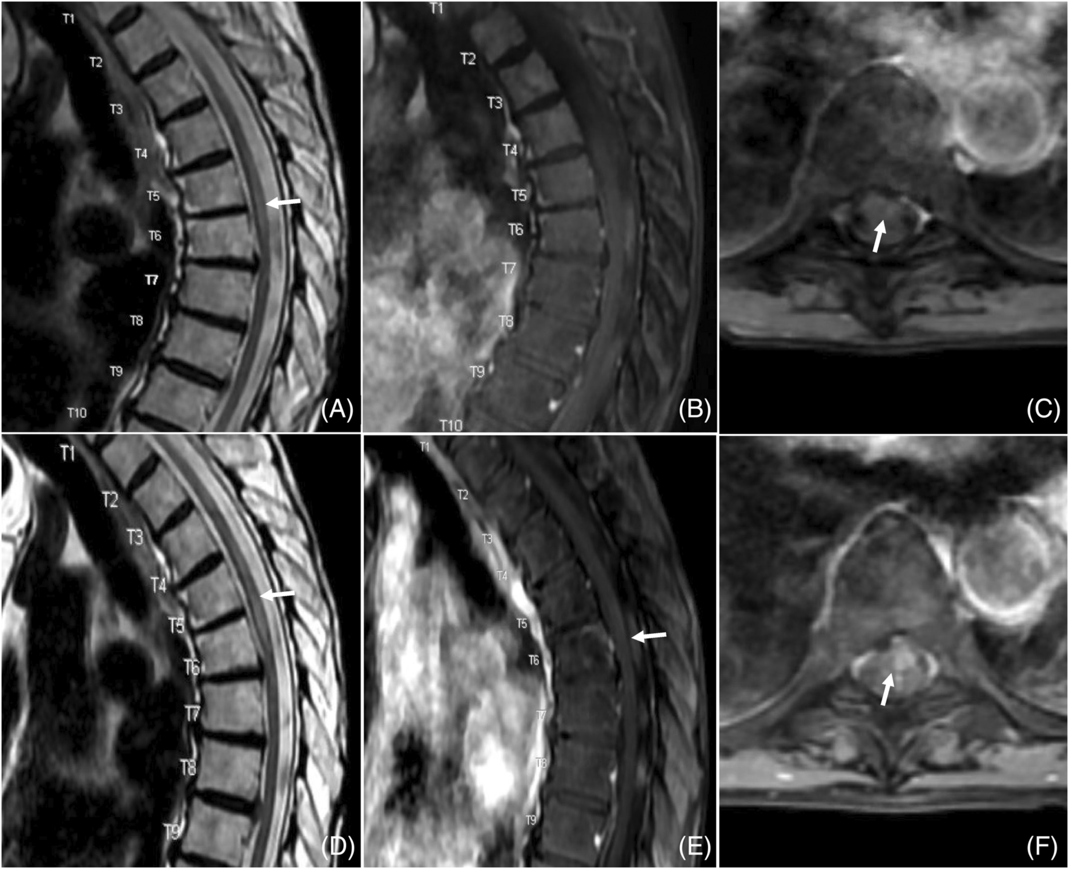
Transverse myelitis following bivalent COVID‐19 booster vaccine and quadrivalent seasonal influenza vaccine
Clinical & Exp Neuroim, First published: 24 January 2023, DOI: (10.1111/cen3.12742)
Notes:
MRI of the thoracic spine was obtained pre‐ and postcontrast administration soon after presentation (upper row, A–C) and 1 wk later (lower row, D–F). T2‐weighted image (A) demonstrates left paramedian hyperintensity centered at the T5–T6 level. There was no discernible enhancement on sagittal T1 postcontrast images (B). However, retrospectively a stippled ill‐defined enhancement was noted at the T5–T6 level (C, white arrow). Follow‐up images showed a more conspicuous T2 hyperintensity extending from T3 to T7 levels (D) along with more discernible enhancement in the left paramedian cord most confluent at the T5–T6 level (E). Additionally, more discrete enhancement was noted on the axial T1 postcontrast images at the T5–T6 level (F, white arrow).
IF THIS IMAGE HAS BEEN PROVIDED BY OR IS OWNED BY A THIRD PARTY, AS INDICATED IN THE CAPTION LINE, THEN FURTHER PERMISSION MAY BE NEEDED BEFORE ANY FURTHER USE. PLEASE CONTACT WILEY'S PERMISSIONS DEPARTMENT ON PERMISSIONS@WILEY.COM OR USE THE RIGHTSLINK SERVICE BY CLICKING ON THE 'REQUEST PERMISSIONS' LINK ACCOMPANYING THIS ARTICLE. WILEY OR AUTHOR OWNED IMAGES MAY BE USED FOR NON-COMMERCIAL PURPOSES, SUBJECT TO PROPER CITATION OF THE ARTICLE, AUTHOR, AND PUBLISHER.

