Slide 1
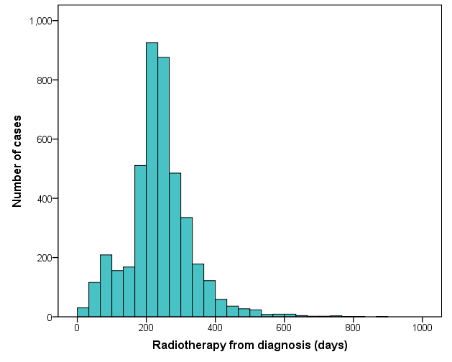
Landmark time point
Supplemental Figure 1. The distribution of the time from cancer diagnosis to start of radiotherapy. The patients who received RT after 12 months (landmark time point) from diagnosis remained the ‘No radiotherapy group’ to ignore change in group membership after the landmark point.
Notes:
Supplemental Figure 1. The distribution of the time from cancer diagnosis to start of radiotherapy. The patients who received RT after 12 months (landmark time point) from diagnosis remained the ‘No radiotherapy group’ to ignore change in group membership after the landmark point.

Slide 2
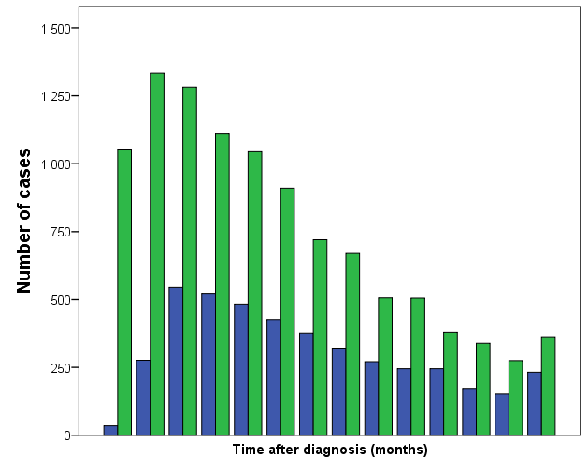
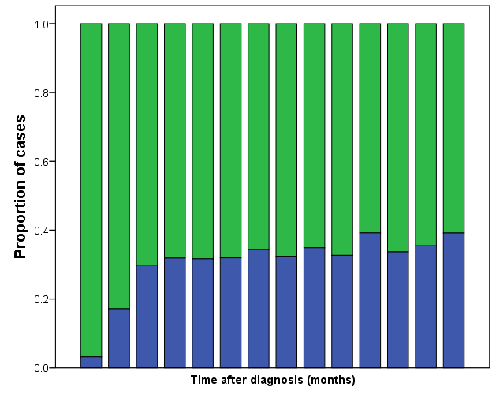
A
B
■ RT
■ No RT
0 6 12 18 24 30 36 42 48 54 60 66 72 78-
0 6 12 18 24 30 36 42 48 54 60 66 72 78-
Overall survival time (months)
Overall survival time (months)
Supplemental Figure 2. The number of cases with and without RT (A) and the rate of RT (B) according to overall survival time. The proportion of radiotherapy was 3.2% among patients who were not alive by 6 months, 17.1% among patients within the 7-12 months survival window, and about 31-38% among patients who survived more than 12 months. This is the reason why the landmark time point was set at 12 months. To ignore all events occurring before the landmark time, we excluded patients whose survival time were 12 months or less after their breast cancer diagnoses.
Notes:
Supplemental Figure 2. The number of cases with and without RT (A) and the rate of RT (B) according to overall survival time. The proportion of radiotherapy was 3.2% among patients who were not alive by 6 months, 17.1% among patients within the 7-12 months survival window, and about 31-38% among patients who survived more than 12 months. This is the reason why the landmark time point was set at 12 months. To ignore all events occurring before the landmark time, we excluded patients whose survival time were 12 months or less after their breast cancer diagnoses.

Slide 3
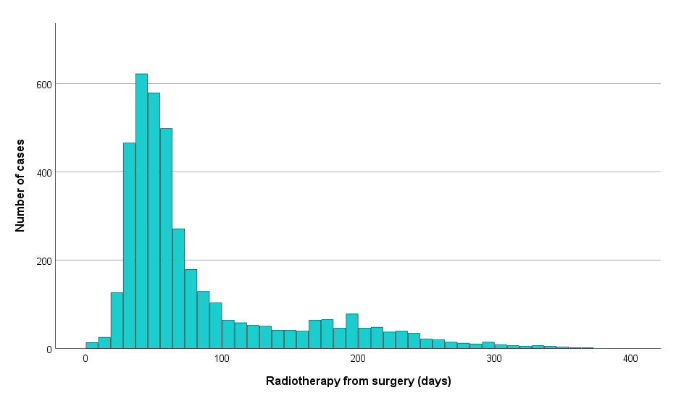
Supplemental Figure 3. The distribution of the time from breast surgery to start of radiotherapy (RT). 77% of patients received RT within 3 months after surgery and 90% of patients received RT within 6 months after surgery.
Notes:
Supplemental Figure 3. The distribution of the time from breast surgery to start of radiotherapy (RT). 77% of patients received RT within 3 months after surgery and 90% of patients received RT within 6 months after surgery.

