Slide 1
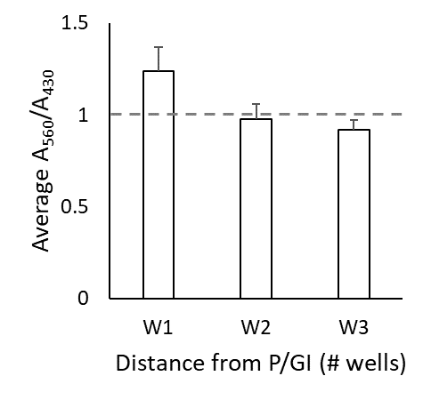
Supplemental Figure 1: Medium 560/430 ratio at 8h
After 8h incubation, the color of the medium changes in response to proximity to P/GI. Medium was sampled in duplicate from the cell culture plates and the absorbances at 560 nm and 430 nm were measured, where higher ratios between them indicate a redder color and higher pH. The graphs depict the average 560/430 ± standard deviation, which have been normalized so that the average expression in unexposed controls equals 1 (dashed line, arbitrary units).
Notes:
RAW 264.7 cells at 400X magnification 24h after addition of LPS (E,F,G,H) or medium control (A,B,C,D) at varying distances from a well containing residual phenol and guanidine isothiocyanate (“P/GI”) or unexposed controls (A,E). Compared to unexposed controls, cells one well away from P/GI (B,F) are smaller and have very rough edges, as in membrane blebbing. This is observed to a lesser extent in cells plated two wells away from P/GI (C,G); minimal effects are seen at distances of 3 wells (D,H) or greater.

Slide 2
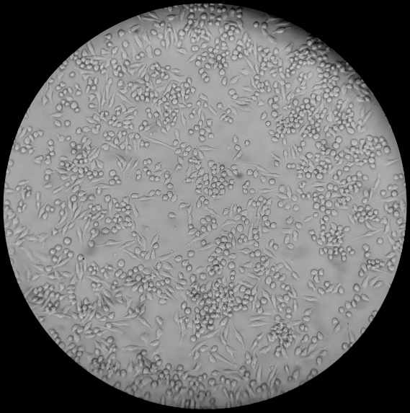
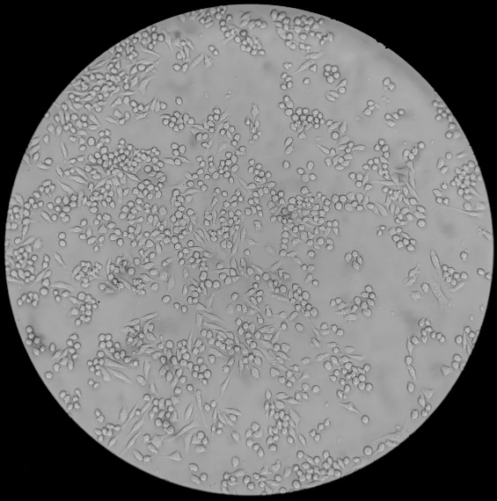
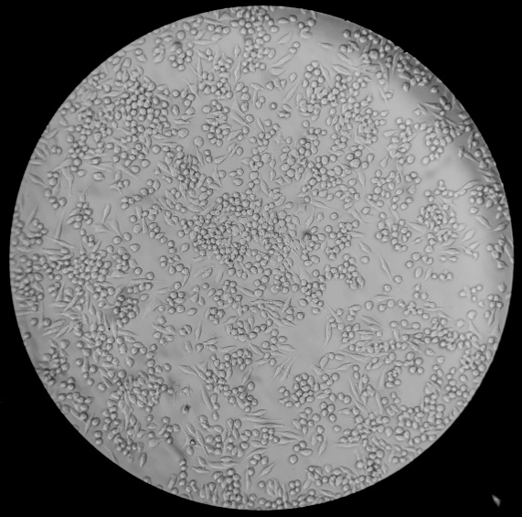
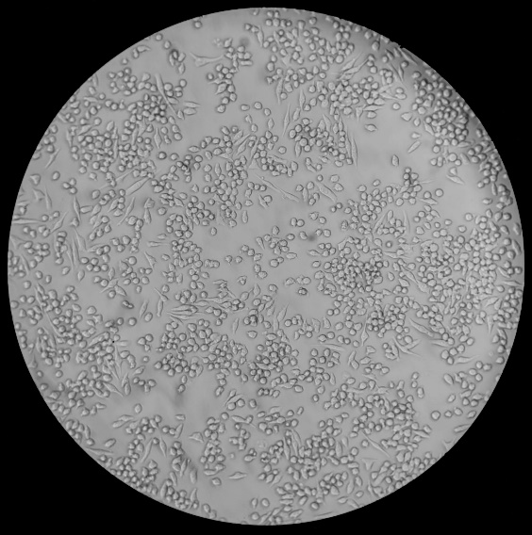

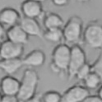


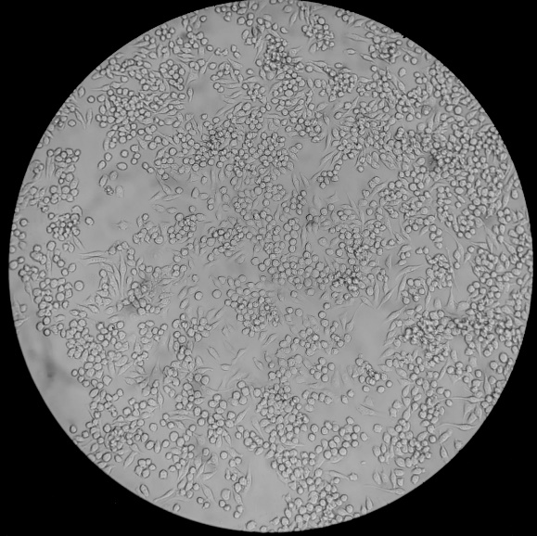
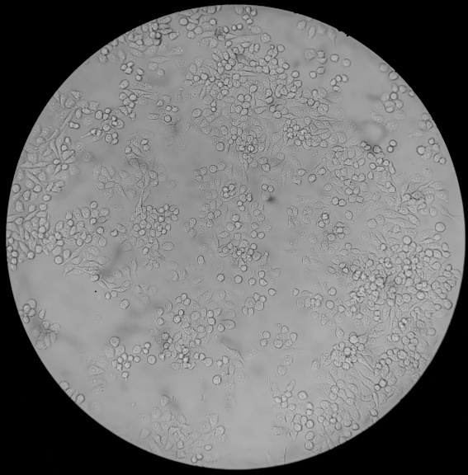
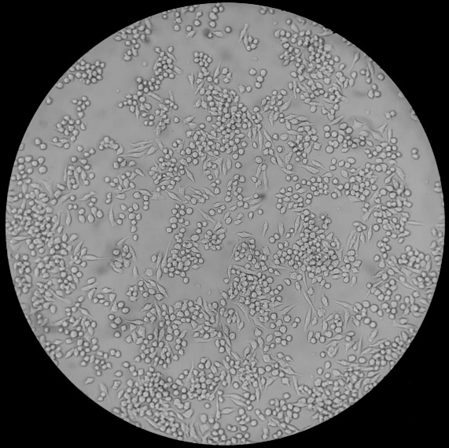
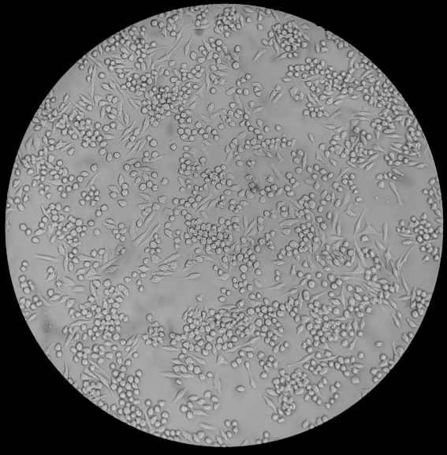




A1
Control
A2
W1
A3
W2
A4
W3
04h
B1
Control
B2
W1
B3
W2
B4
W3
08h
Supplemental Figure 2: Cell morphology at 4h and 8h
RAW 264.7 cells at 400X magnification at various distances (W1, W2, or W3) from P/GI for 4h (A2, A3, and A4) or 8h (B2, B3, and B4) and time-matched P/GI-unexposed controls (A1 and B1).
Notes:
RAW 264.7 cells at 400X magnification 24h after addition of LPS (E,F,G,H) or medium control (A,B,C,D) at varying distances from a well containing residual phenol and guanidine isothiocyanate (“P/GI”) or unexposed controls (A,E). Compared to unexposed controls, cells one well away from P/GI (B,F) are smaller and have very rough edges, as in membrane blebbing. This is observed to a lesser extent in cells plated two wells away from P/GI (C,G); minimal effects are seen at distances of 3 wells (D,H) or greater.

Slide 3
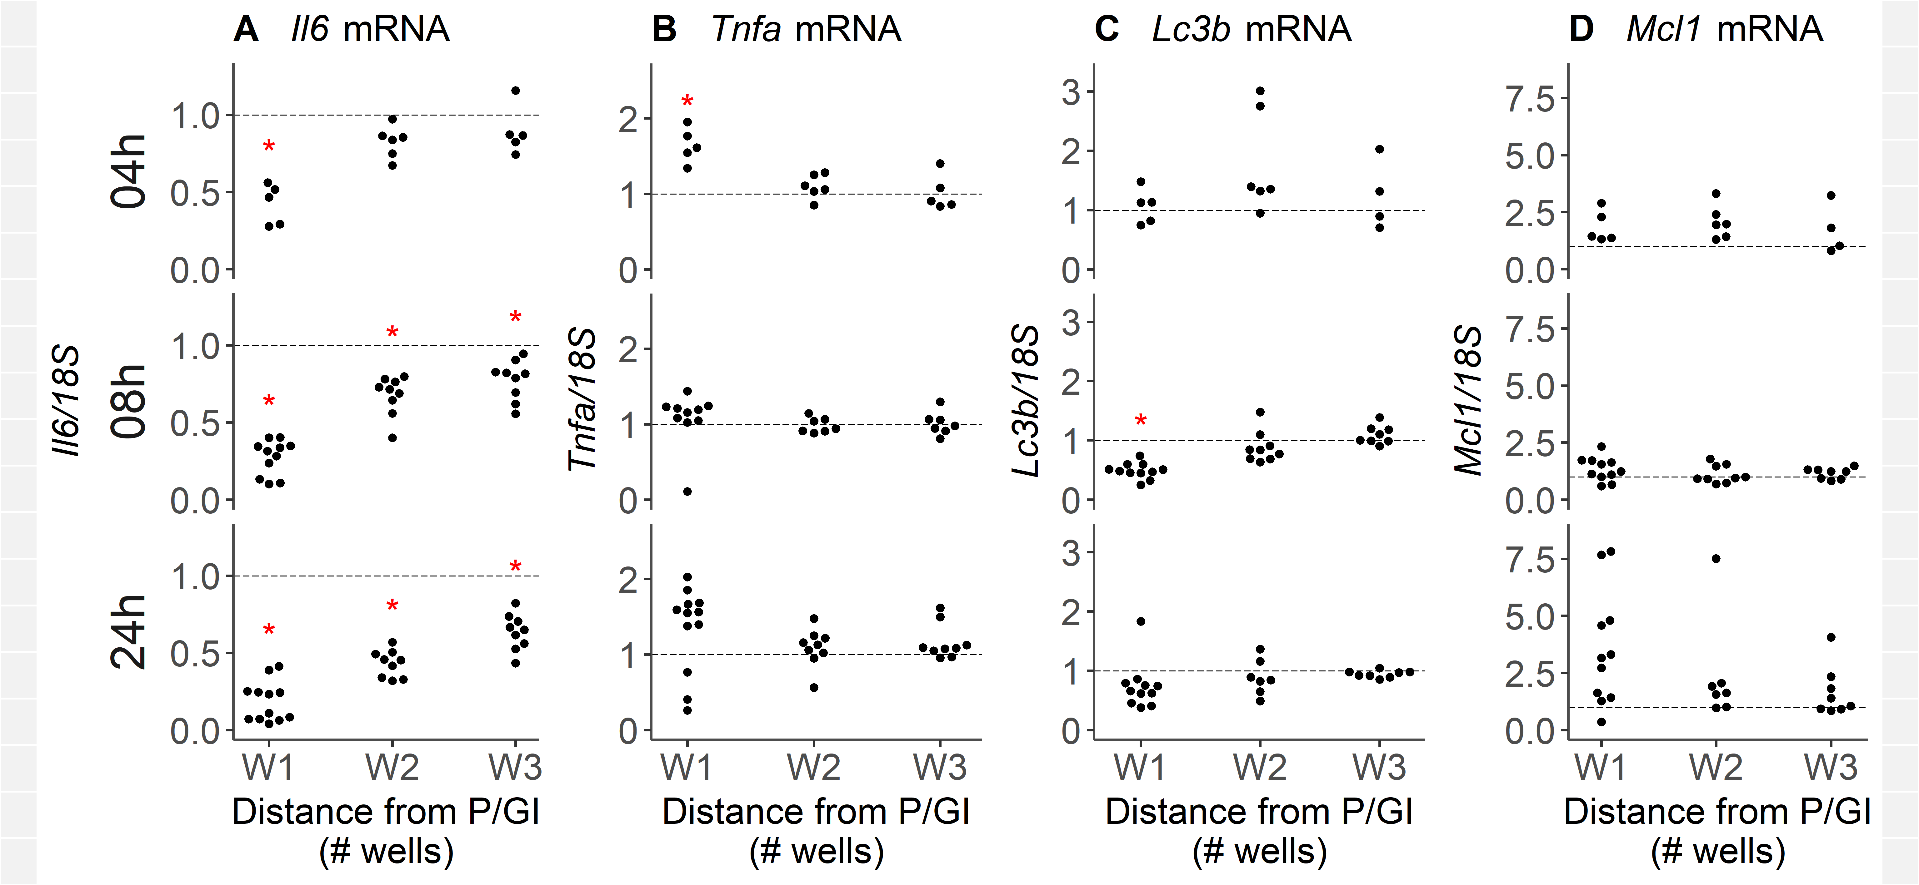
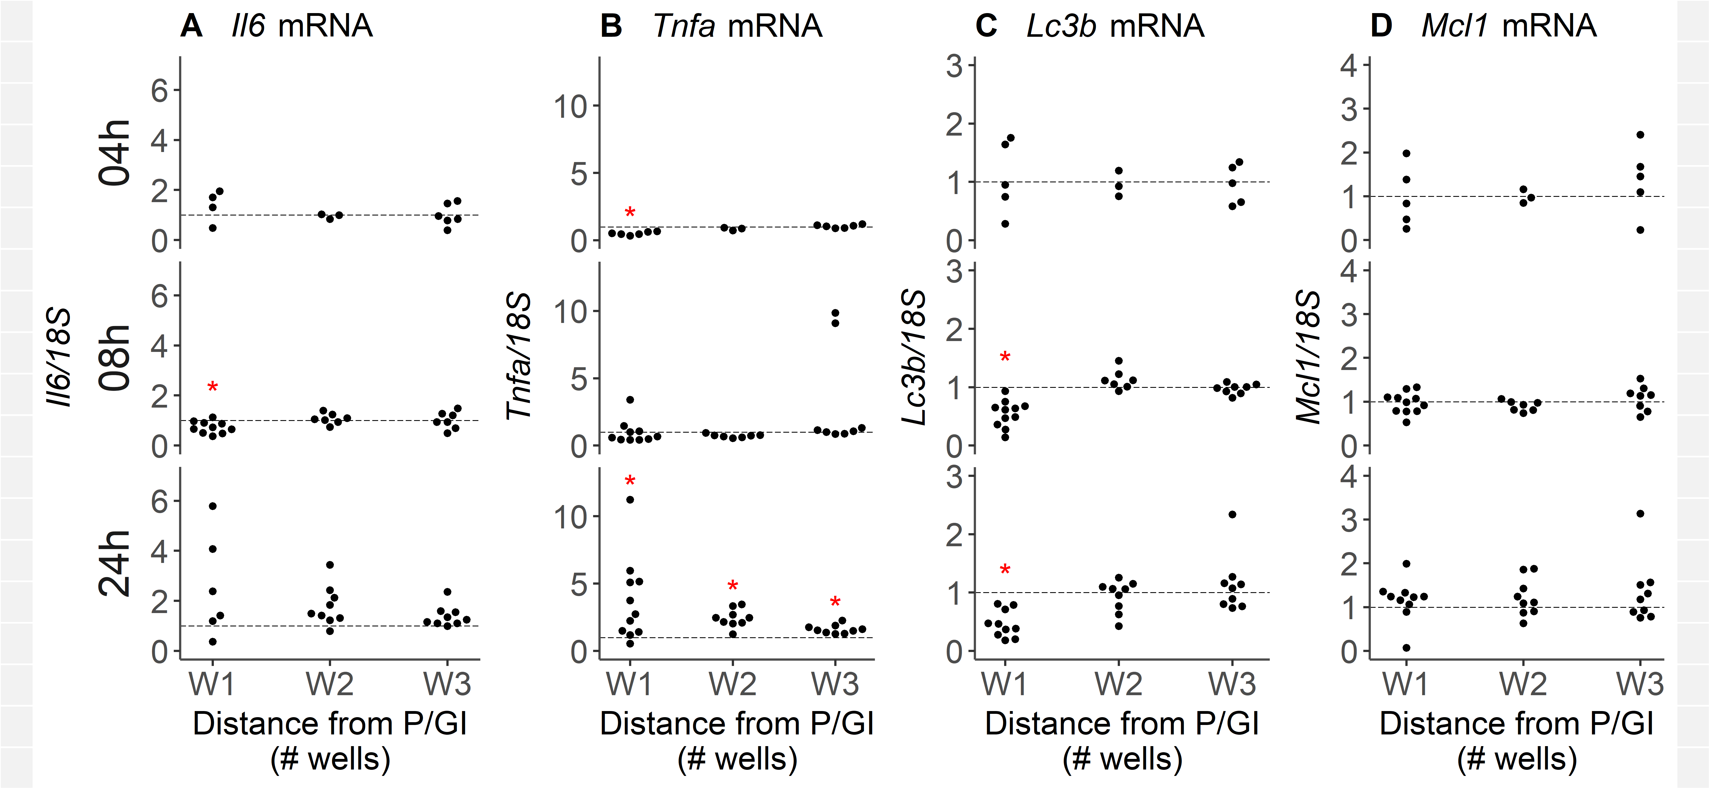
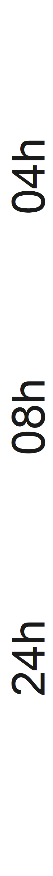
Supplemental Figure 3: All gene expression data for LPS- experiments
RT-PCR data measuring expression of Mcl1 (A), Lc3b (B), Tnfα (C) and Il6 (D) transcripts in RAW 264.7 cells cultured at various distances from P/GI residue for 4h (top row), 8h (middle row), or 24h (bottom row). Hrk was not detected.Transcripts are normalized so that the average expression in unexposed controls equals 1 (dashed line, arbitrary units). Distances at which P/GI-exposed gene expression significantly differed (p < 0.05) from unexposed controls are marked with a red asterisk (*).

Slide 4
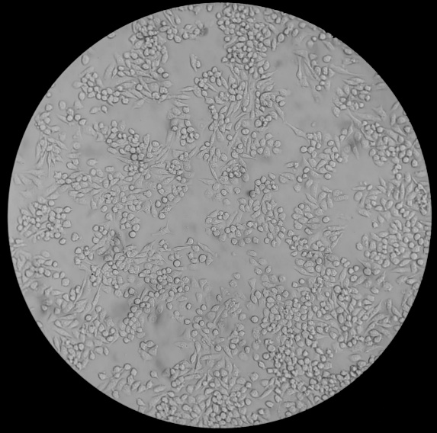
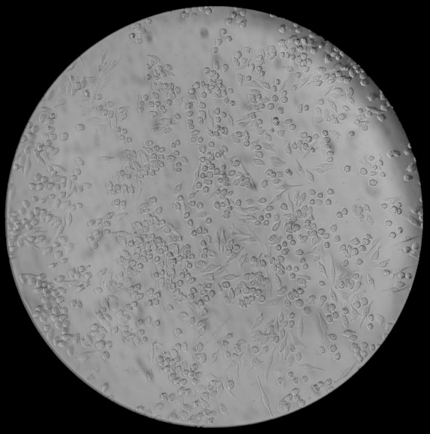
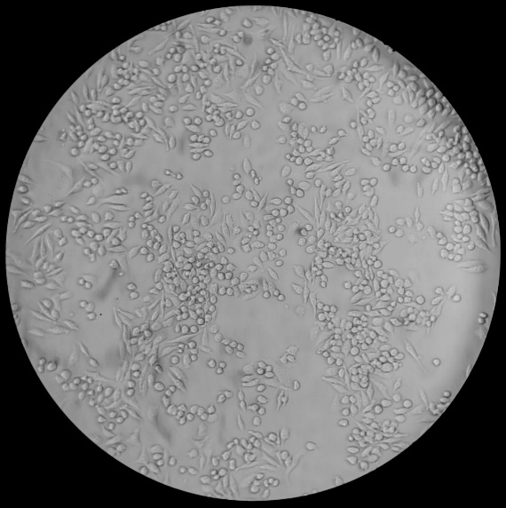
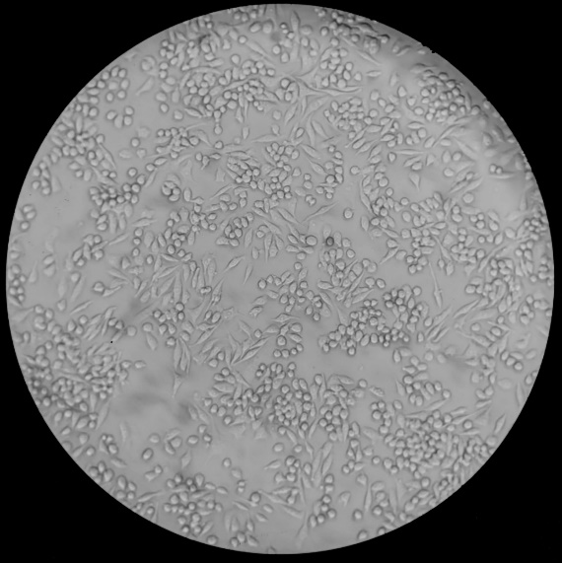


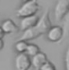
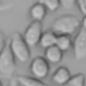
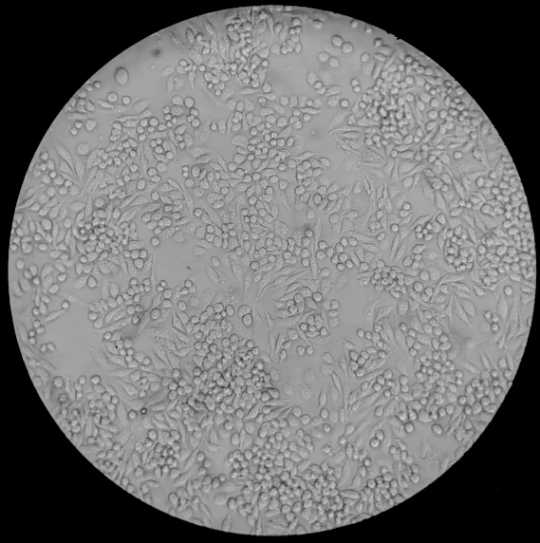
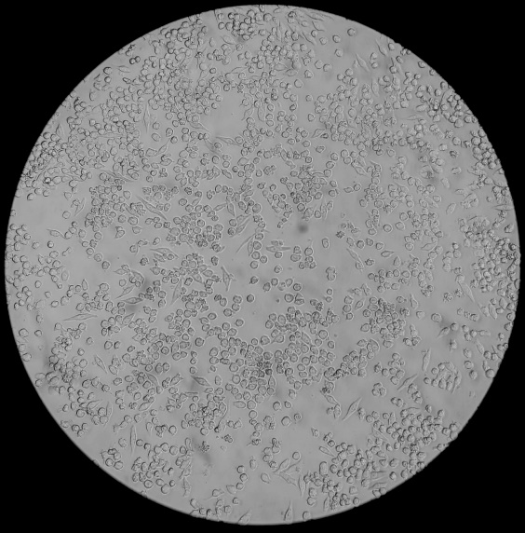
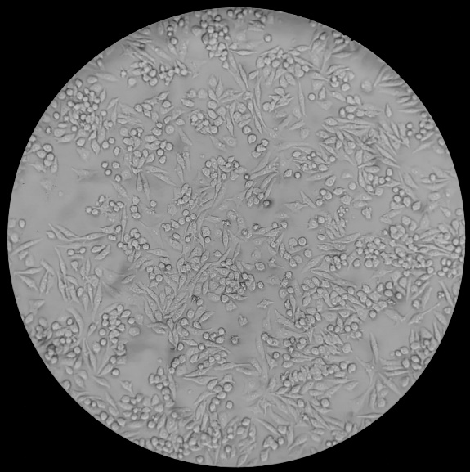
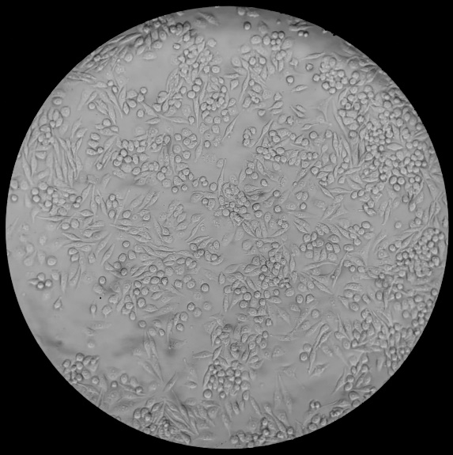




LPS
LPS + P/GI
A1
Control
A2
W1
A3
W2
A4
W3
04h
B1
Control
B2
W1
B3
W2
B4
W3
08h
Supplemental Figure 4: LPS-stimulated cell morphology at 4h and 8h
RAW 264.7 cells stimulated with 0.2 ng/mL LPS at 400X magnification at various distances (W1, W2, or W3) from P/GI for 4h (A2, A3, and A4) or 8h (B2, B3, and B4) and time-matched P/GI-unexposed controls (A1 and B1).
Notes:
RAW 264.7 cells at 400X magnification 24h after addition of LPS (E,F,G,H) or medium control (A,B,C,D) at varying distances from a well containing residual phenol and guanidine isothiocyanate (“P/GI”) or unexposed controls (A,E). Compared to unexposed controls, cells one well away from P/GI (B,F) are smaller and have very rough edges, as in membrane blebbing. This is observed to a lesser extent in cells plated two wells away from P/GI (C,G); minimal effects are seen at distances of 3 wells (D,H) or greater.

Slide 5
Supplemental Figure 5: Additional gene expression data for LPS+ experiments
RT-PCR data measuring expression of Tnfα (A), Lc3b (B), and Mcl1 (C) transcripts in LPS-stimulated RAW 264.7 cells cultured at various distances from P/GI residue for 4h (top row), 8h (middle row), or 24h (bottom row). Hrk was not detected. Transcripts are normalized so that the average expression in LPS-stimulated, unexposed controls equals 1 (dashed line, arbitrary units). Distances at which P/GI-exposed gene expression significantly differed (p < 0.05) from unexposed controls are marked with a red asterisk (*).

