Slide 1

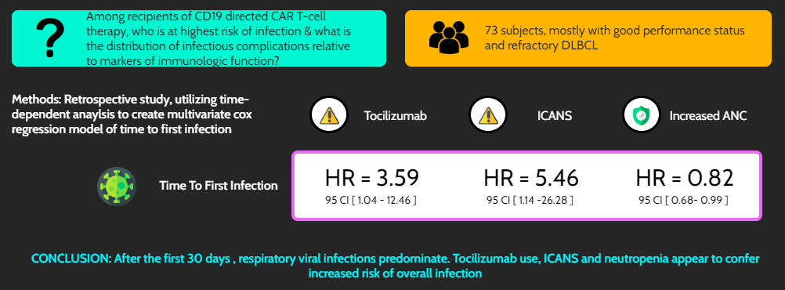
Infectious Complications of CAR T-cell Therapy: A Longitudinal Risk Model
Czapka et al. Transplant Infectious Diseases. 2023.
@TheTxIDJournal @TheMikerobiome

